Slide 1

Comparison of forward Uncertainty Quantification methods
Update meeting
2
Paul-Baptiste Rubio, Tianxiang Su, Muhannad Abuhaikal and Youssef Marzouk
1
2
1
Department of Aeronautics and Astronautics
Massachusetts Institute of Technology
1
Schlumberger-Doll Research
2
Monday, March 23

Slide 2
Outline
Accuracy
Computation time
Estimation of Quantities Of Interest
Conclusions and prospects

Slide 3
Outline
Accuracy
Computation time
Estimation of Quantities Of Interest
Conclusions and prospects

Slide 4
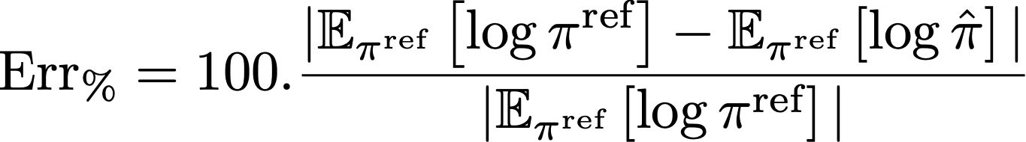
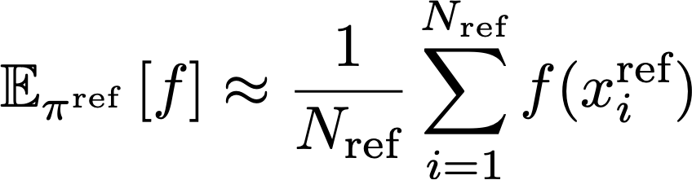
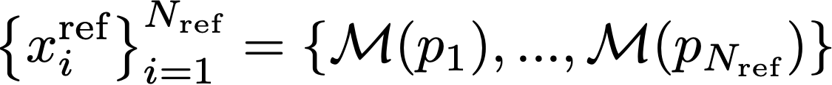
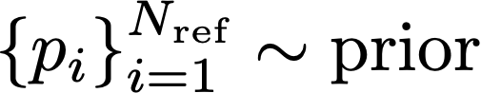
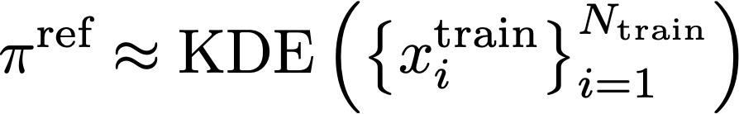

Accuracy
Methods: Transport map with Gauss quadrature, Transport map with MC quadrature, KDE.
KL based error estimation:
reference density
approximated density
Error in %:
with
(Control samples)
and
(Training samples)

Slide 5
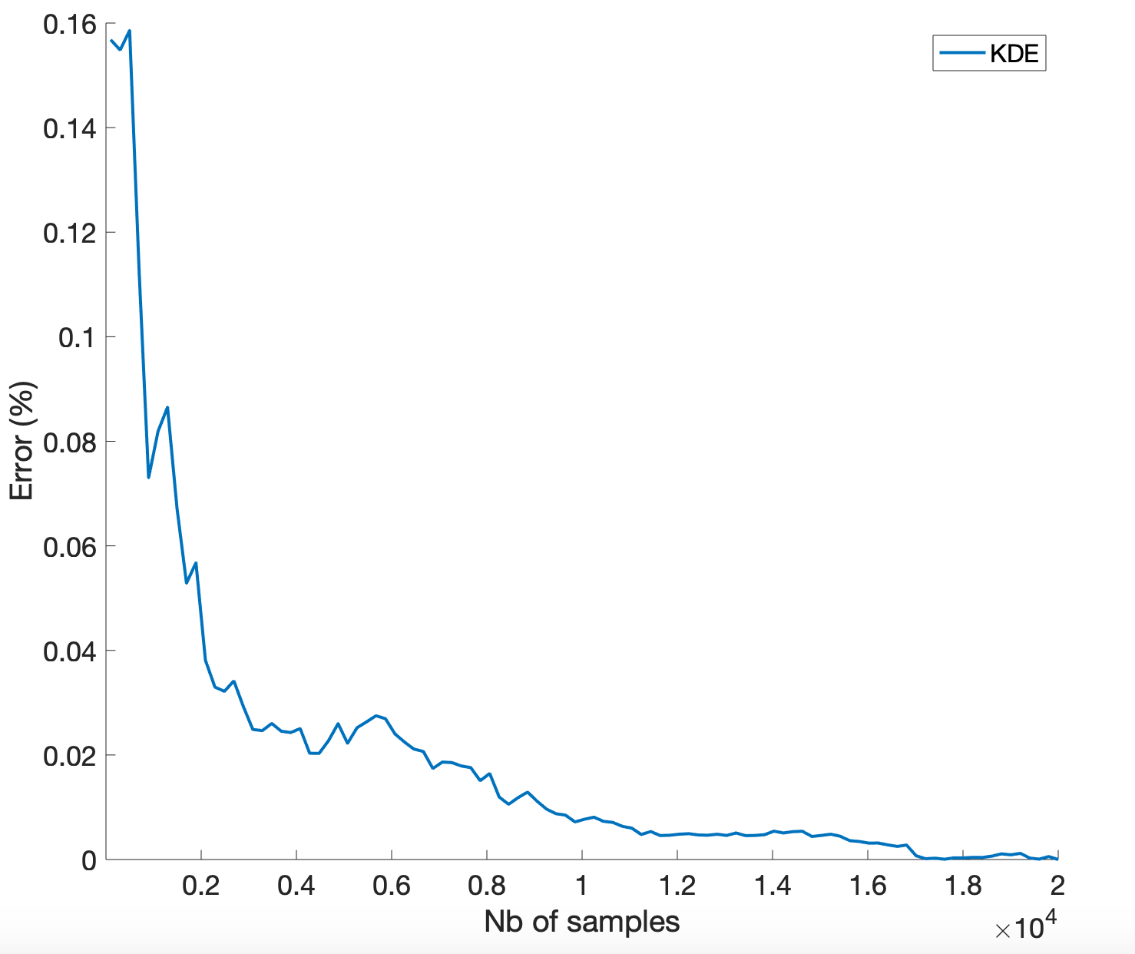
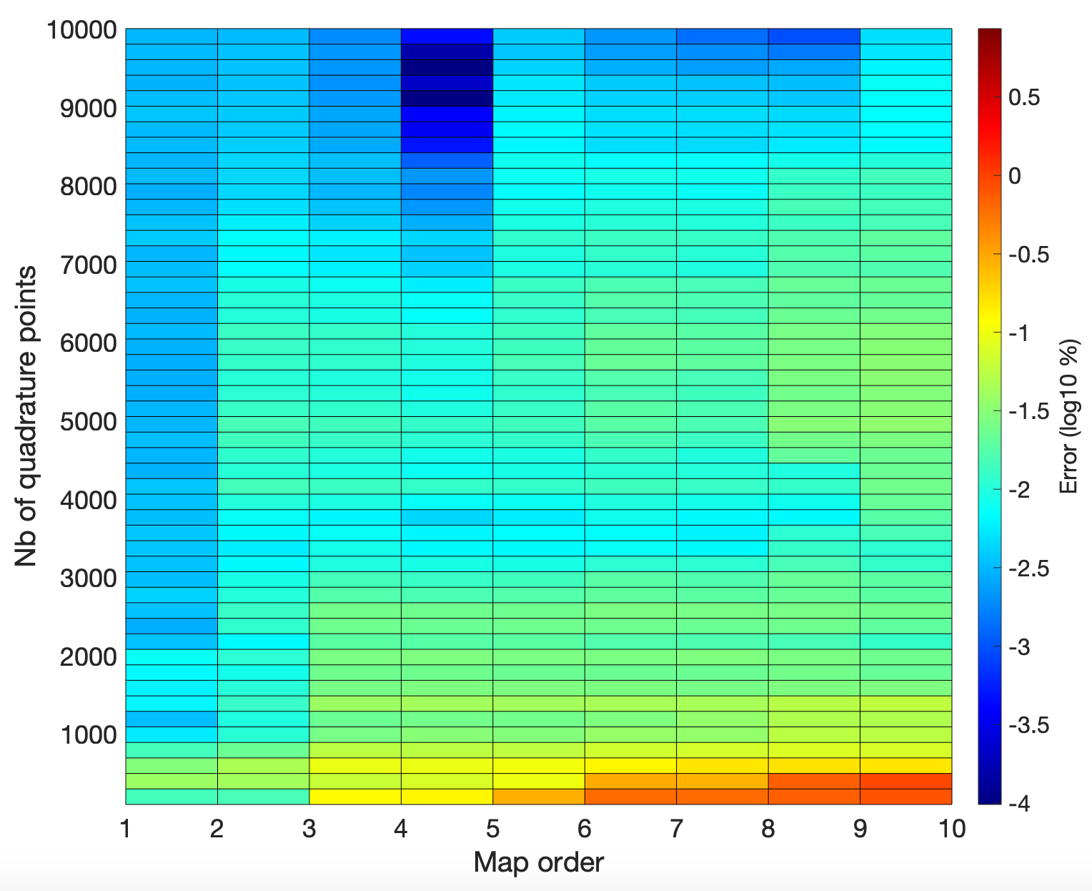
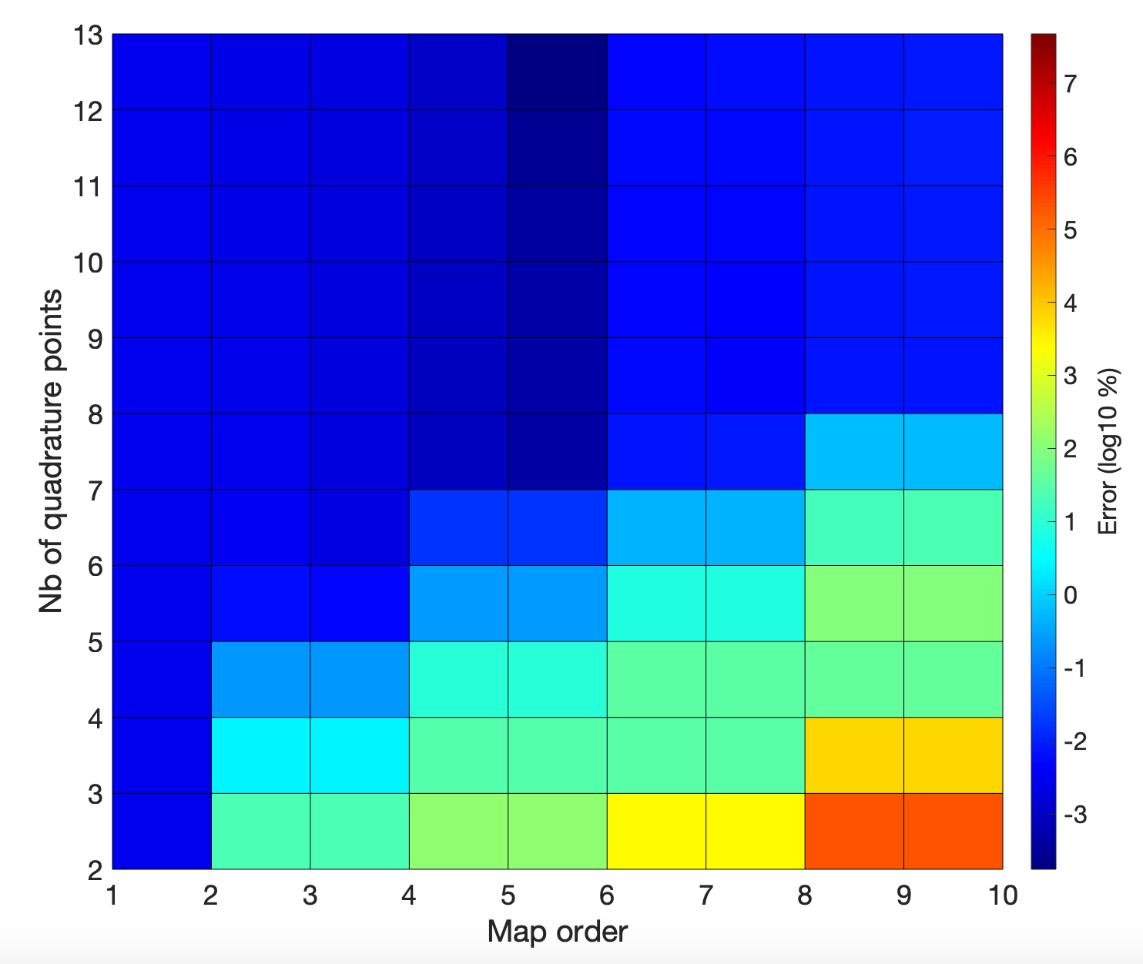
Accuracy
Uncertain input: friction coefficient
Gaussian pdf with $μ=0.25$ and $σ=0.08$ truncated at 0
Pdf to approximate: Tension at the surface for the given true well
Kernel Density Estimation
Transport Map MC:
Transport Map GQ:

Slide 6
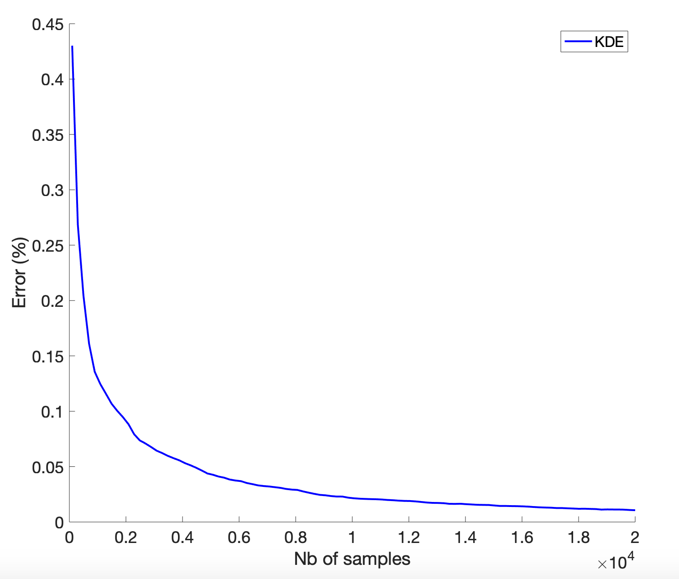
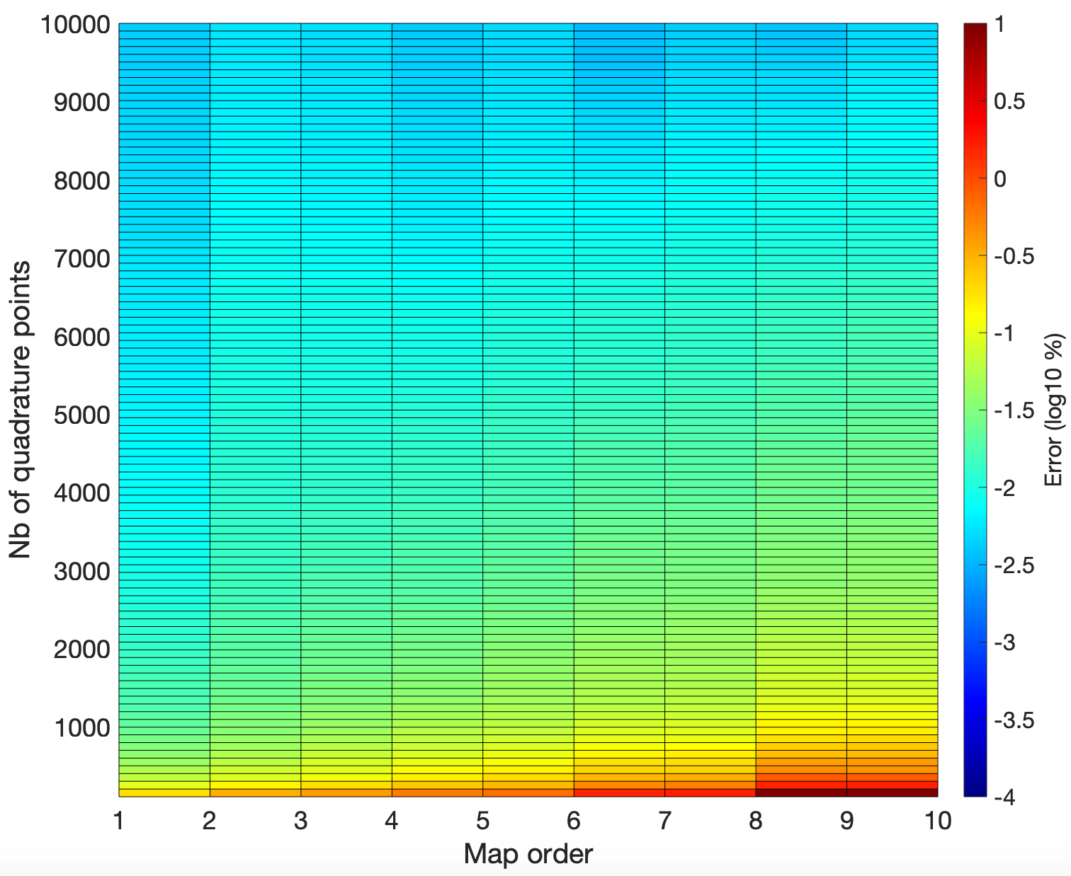
Accuracy
Uncertain input: friction coefficient
Gaussian pdf with $μ=0.25$ and $σ=0.08$ truncated at 0
Pdf to approximate: Tension at the surface for the given true well
Kernel Density Estimation
Transport Map MC:
Transport Map GQ:

Slide 7
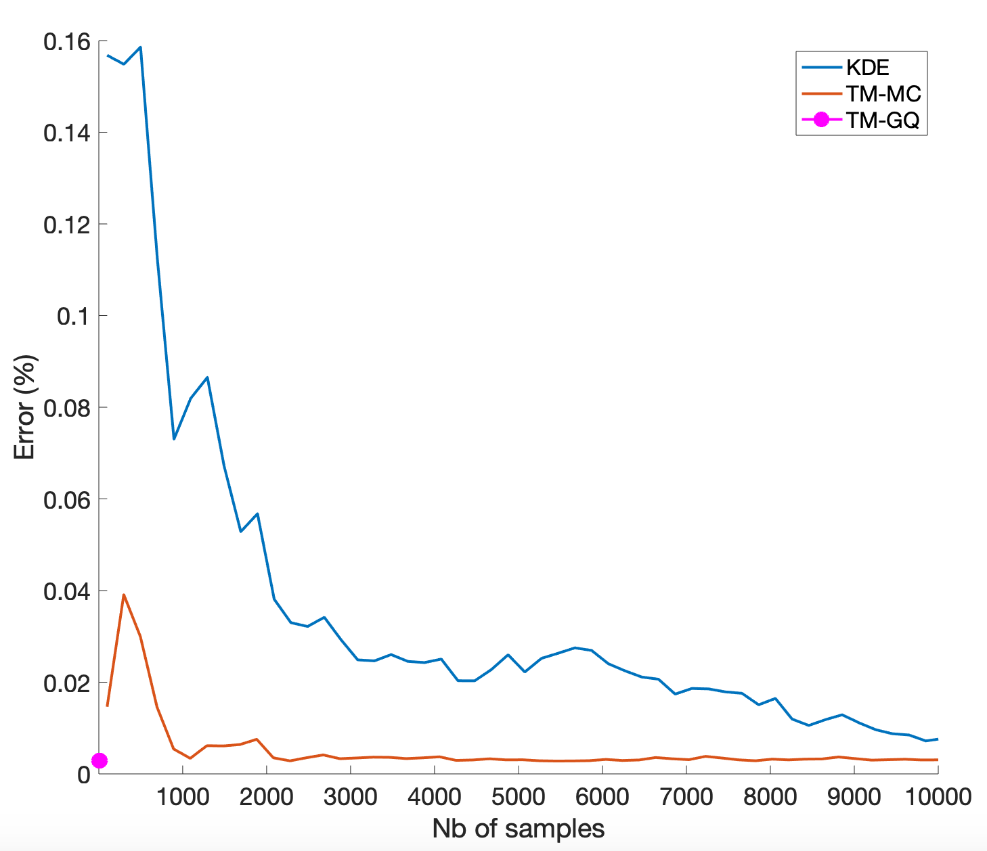
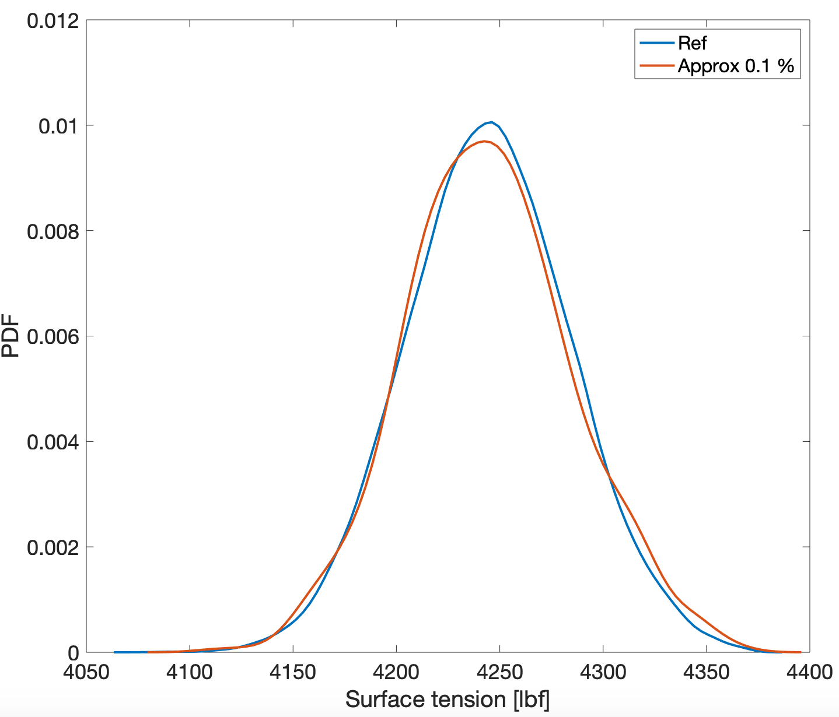
Accuracy
Comparison
KDE vs TM
Approximation at 0.1 %
$${\text{Err}}_{μ}=0.0015\%$$
$${\text{Err}}_{σ}=1.25\%$$
Standard deviation of the output: 39.7 lbf

Slide 8
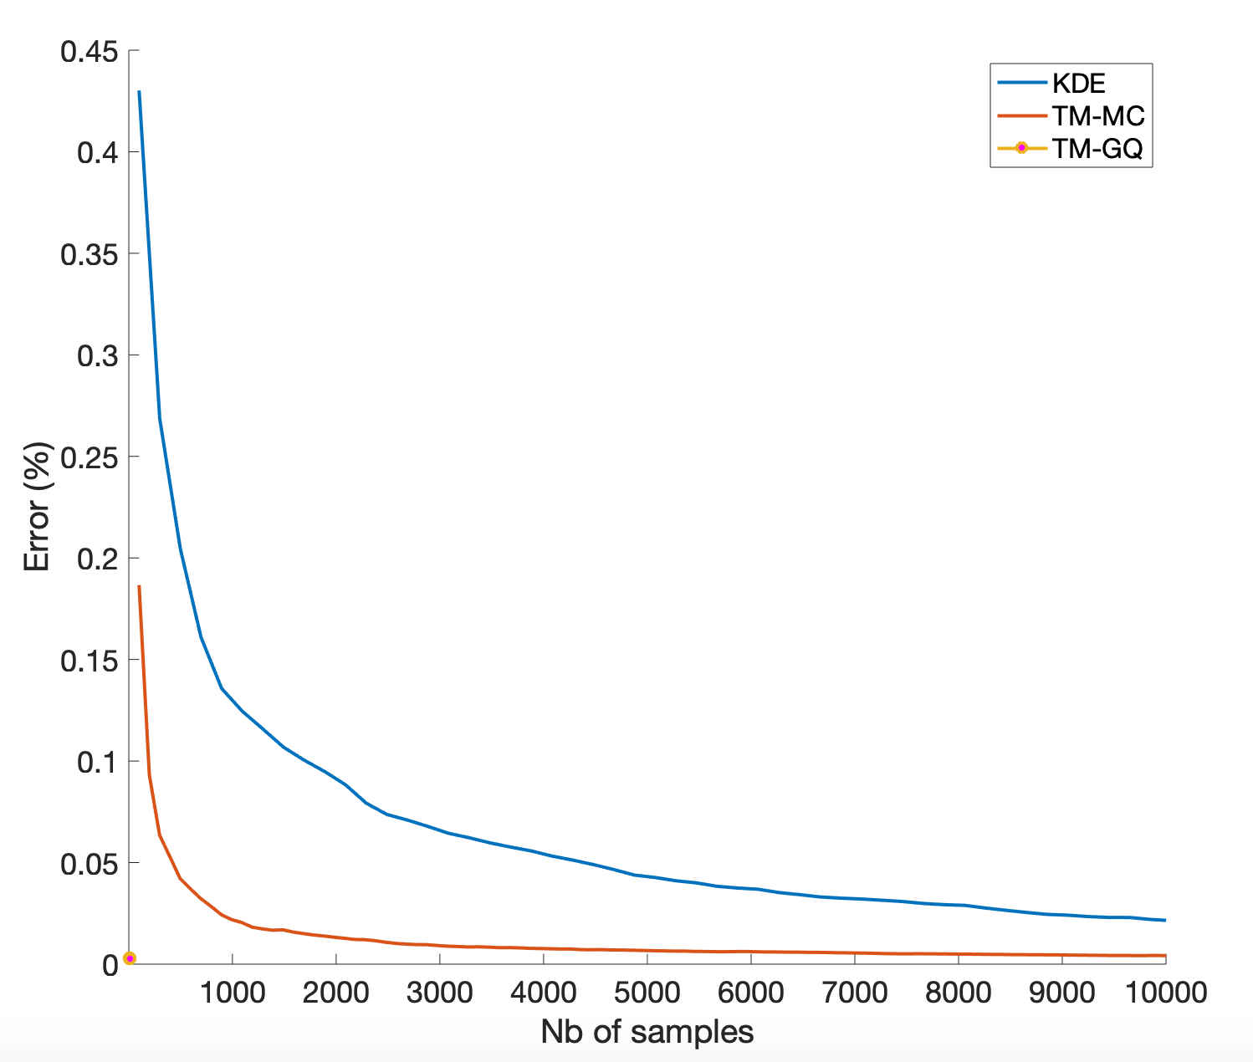
Accuracy
Comparison
KDE vs TM
Approximation at 0.1 %
$${\text{Err}}_{μ}=0.0015\%$$
$${\text{Err}}_{σ}=1.25\%$$
Standard deviation of the output: 39.7 lbf

Slide 9
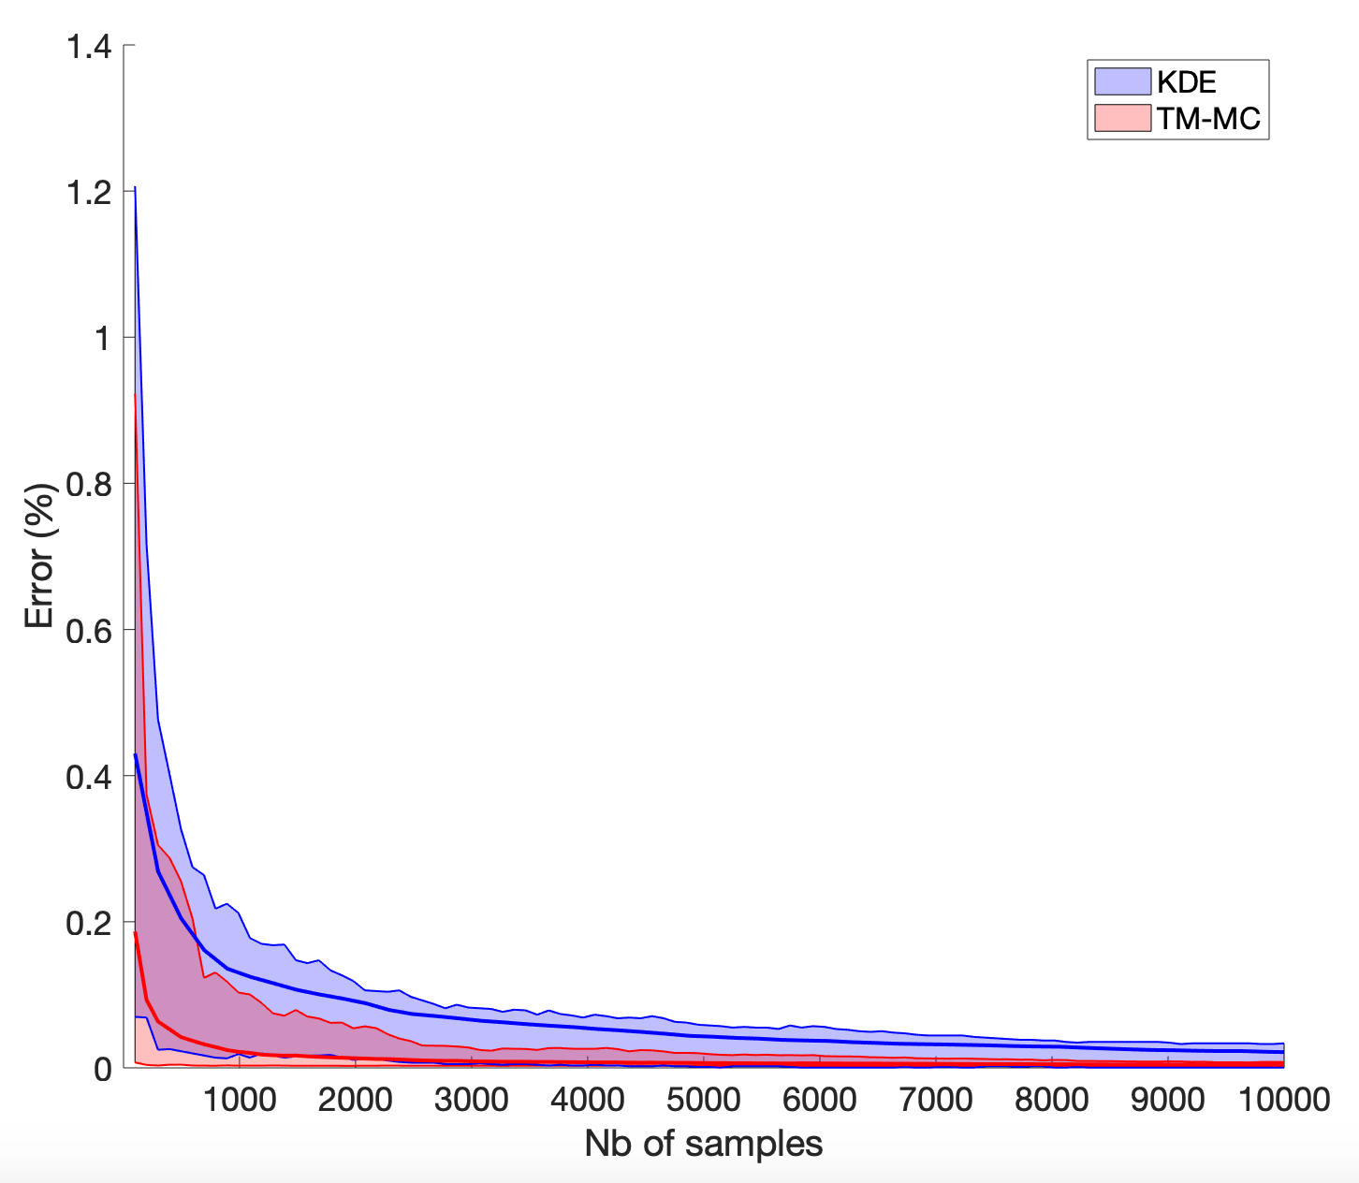
Accuracy
Comparison
KDE vs TM
Approximation at 0.1 %
$${\text{Err}}_{μ}=0.0015\%$$
$${\text{Err}}_{σ}=1.25\%$$
Standard deviation of the output: 39.7 lbf

Slide 10
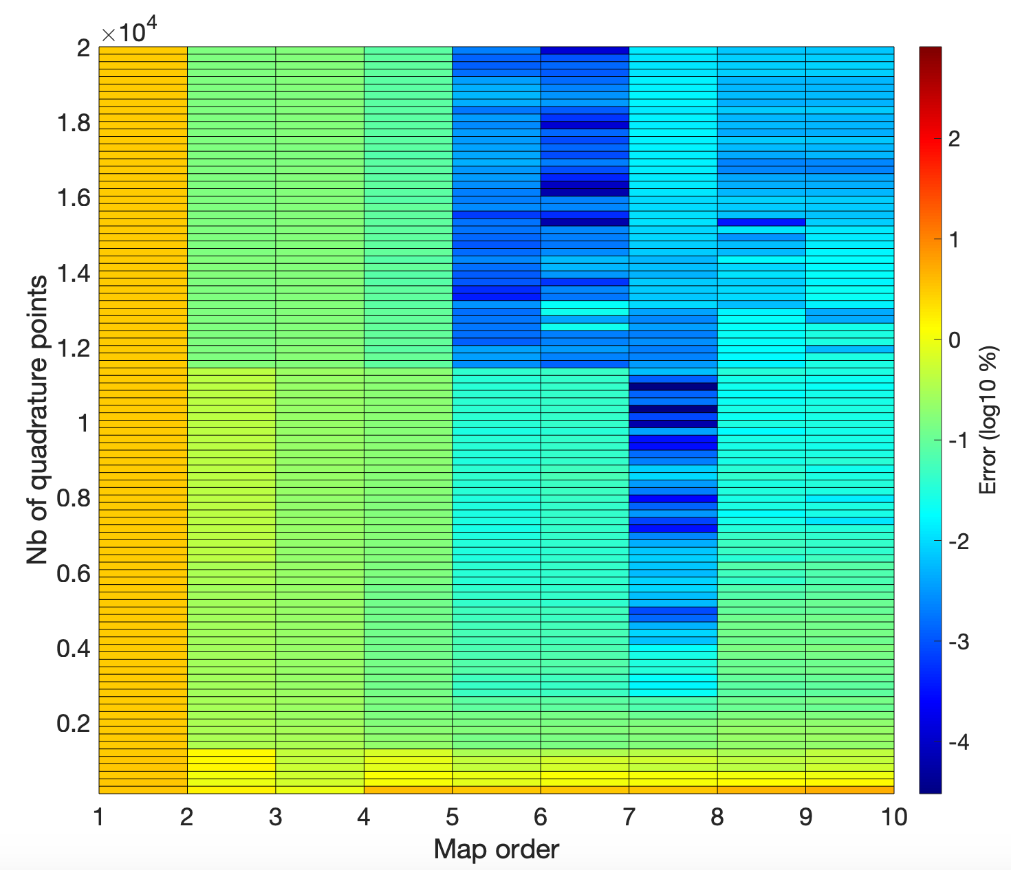
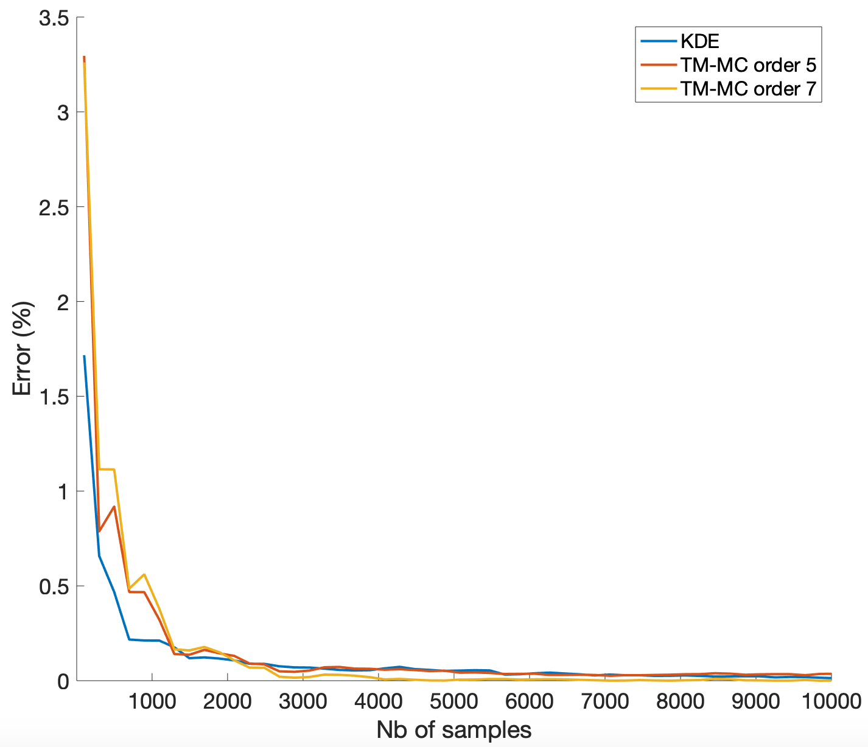
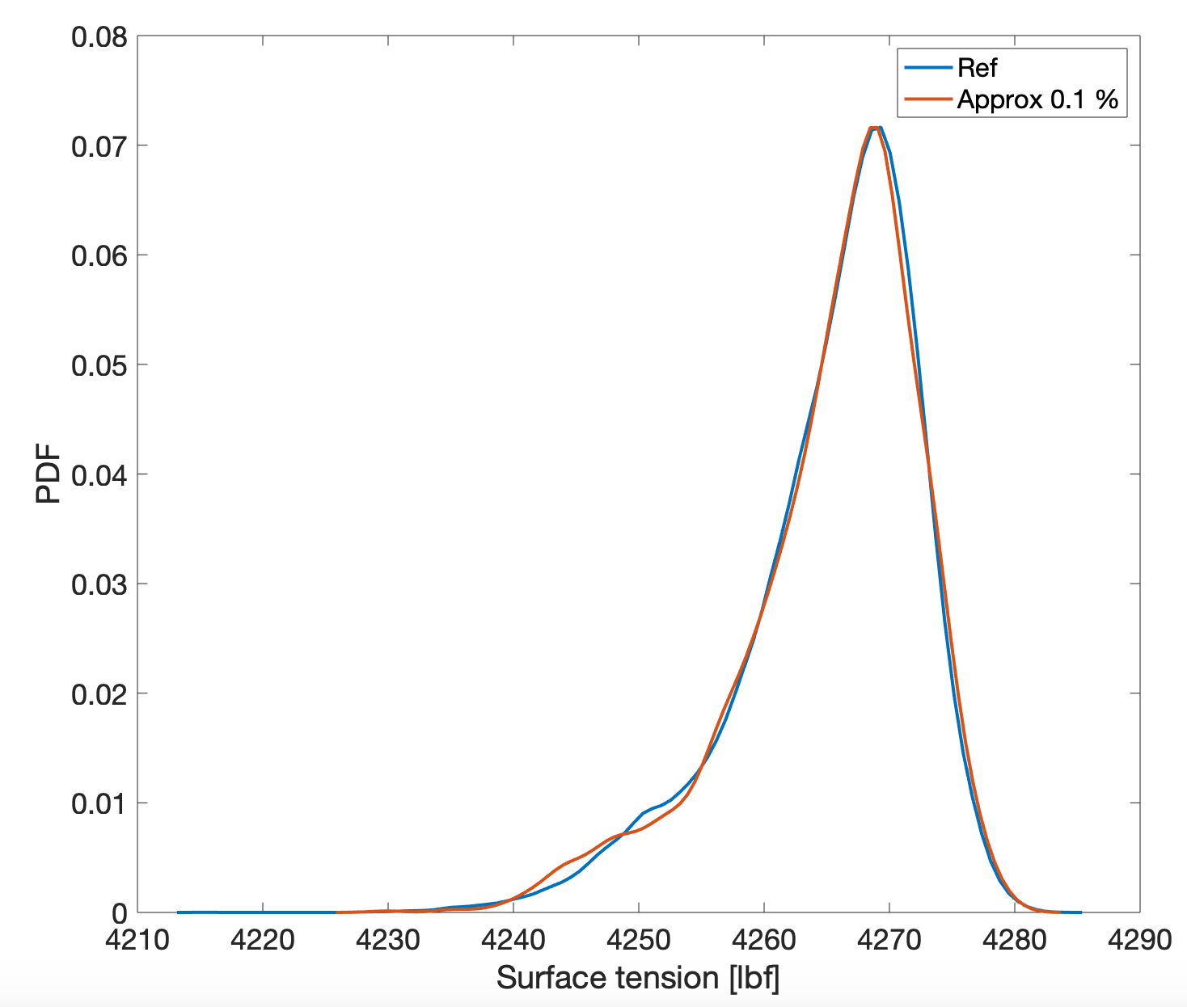
Accuracy
Uncertain input: well trajectory (noise on survey points)
Gaussian white noise with $σ_{\text{incl}}={0.02}^{∘}$ and $σ_{\text{azi}}={0.1}^{∘}$
Pdf to approximate: Tension at the surface for the given true well
TM with MC quadrature
KDE vs TM
Approximation at 0.1%
$${\text{Err}}_{μ}=3.6×{10}^{-4}\%$$
$${\text{Err}}_{σ}=1.14\%$$

Slide 11
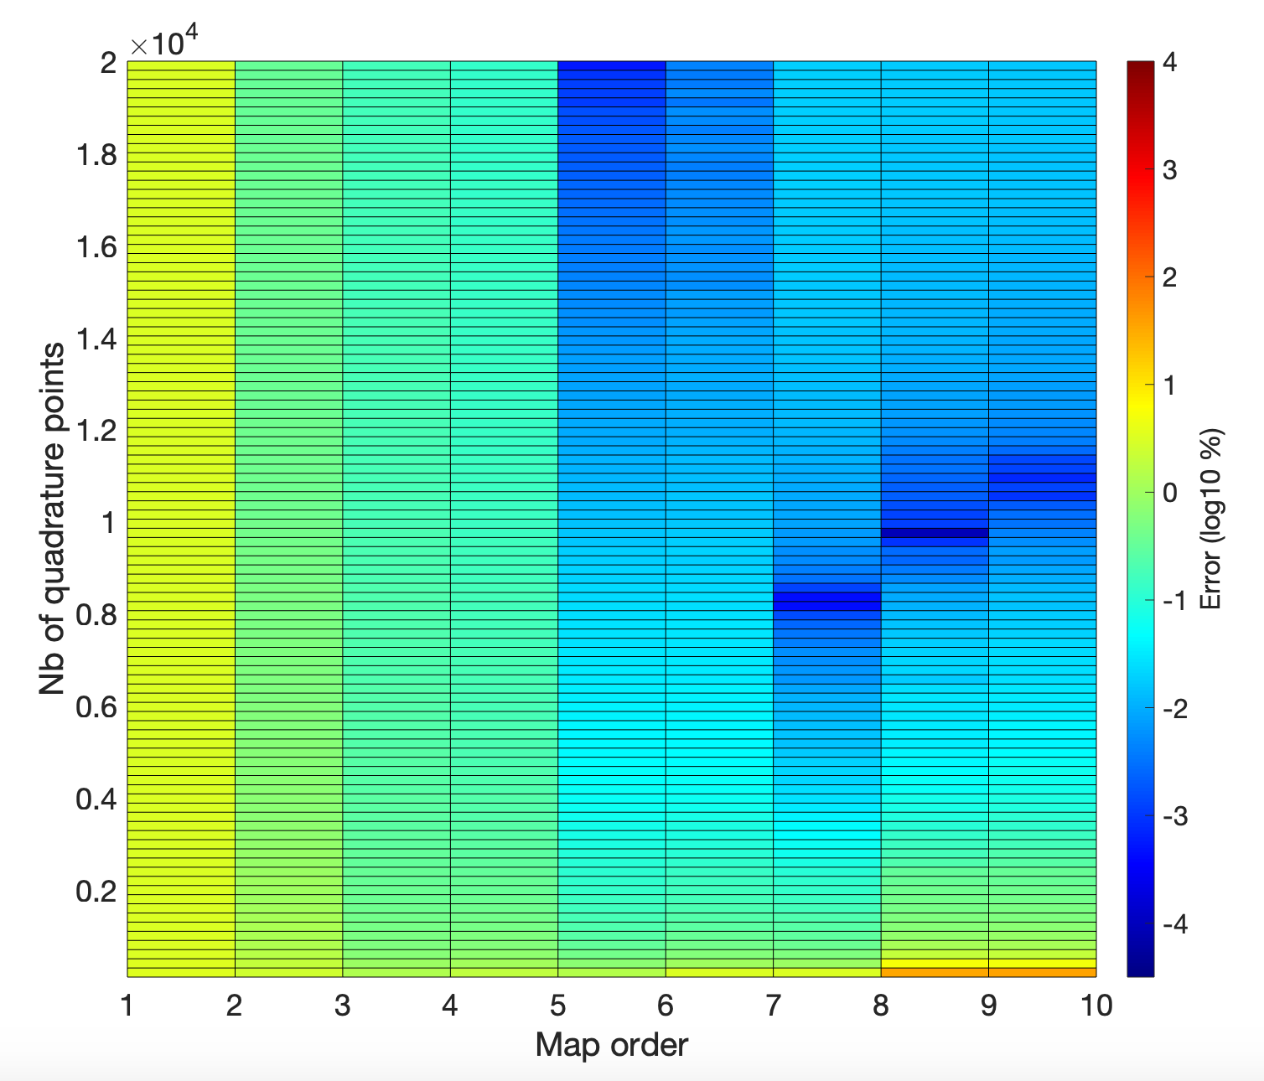
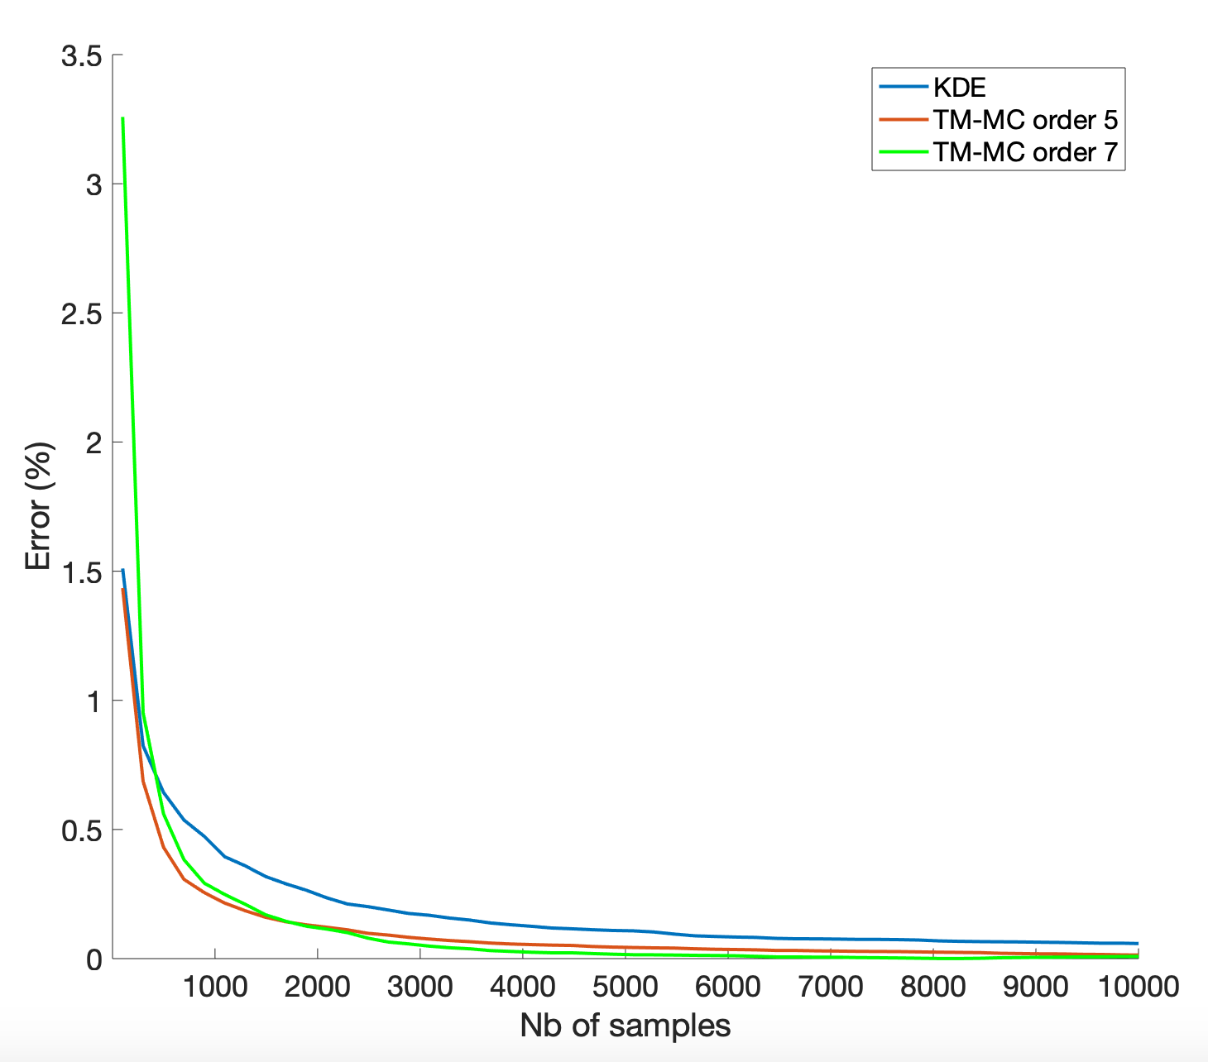
Accuracy
Uncertain input: well trajectory (noise on survey points)
Gaussian white noise with $σ_{\text{incl}}={0.02}^{∘}$ and $σ_{\text{azi}}={0.1}^{∘}$
Pdf to approximate: Tension at the surface for the given true well
TM with MC quadrature
KDE vs TM
Approximation at 0.1%
$${\text{Err}}_{μ}=3.6×{10}^{-4}\%$$
$${\text{Err}}_{σ}=1.14\%$$

Slide 12
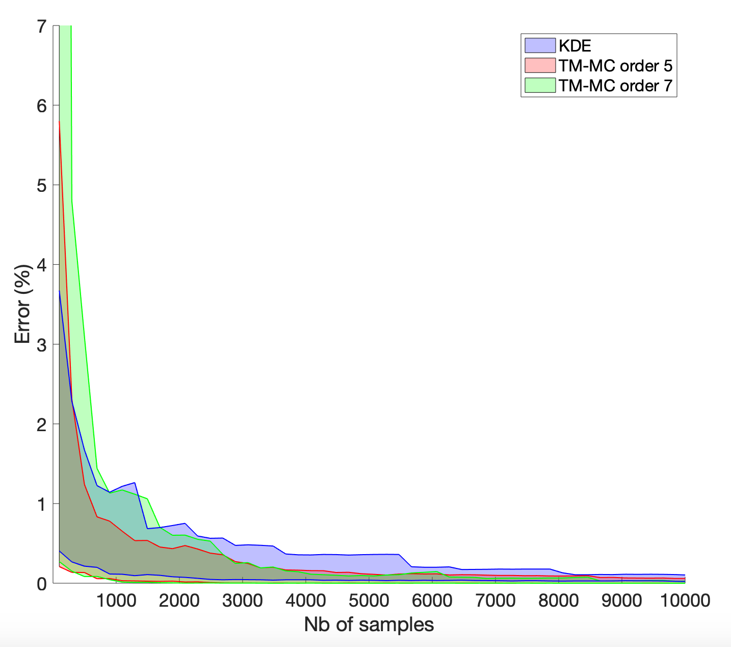
Accuracy
Uncertain input: well trajectory (noise on survey points)
Gaussian white noise with $σ_{\text{incl}}={0.02}^{∘}$ and $σ_{\text{azi}}={0.1}^{∘}$
Pdf to approximate: Tension at the surface for the given true well
TM with MC quadrature
KDE vs TM
Approximation at 0.1%
$${\text{Err}}_{μ}=3.6×{10}^{-4}\%$$
$${\text{Err}}_{σ}=1.14\%$$

Slide 13
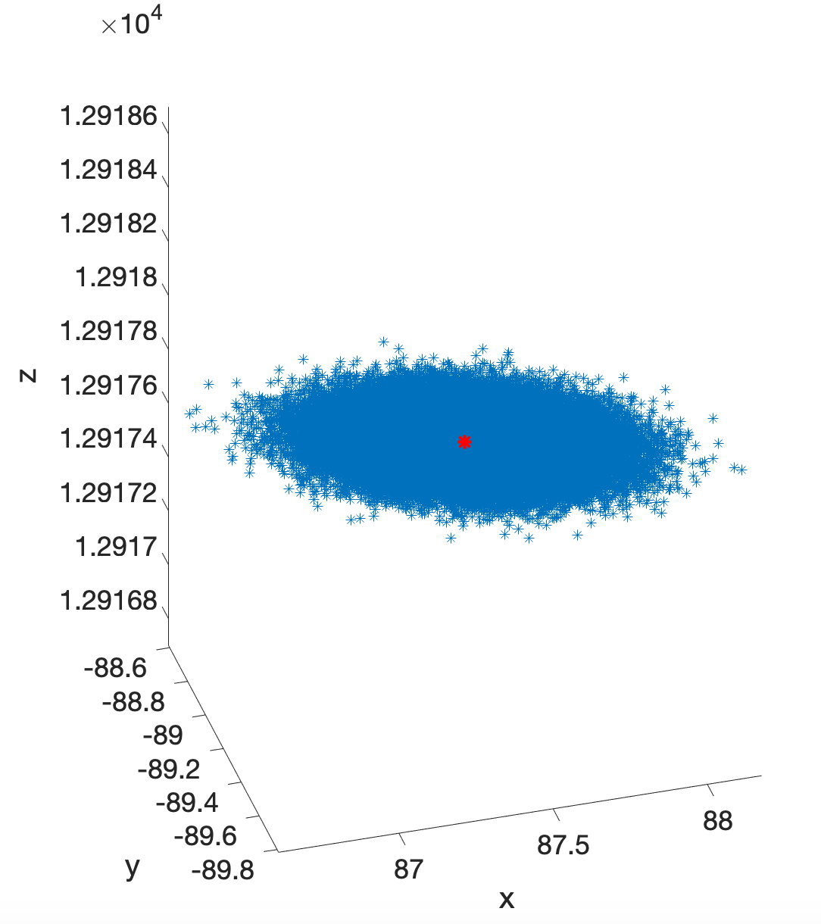
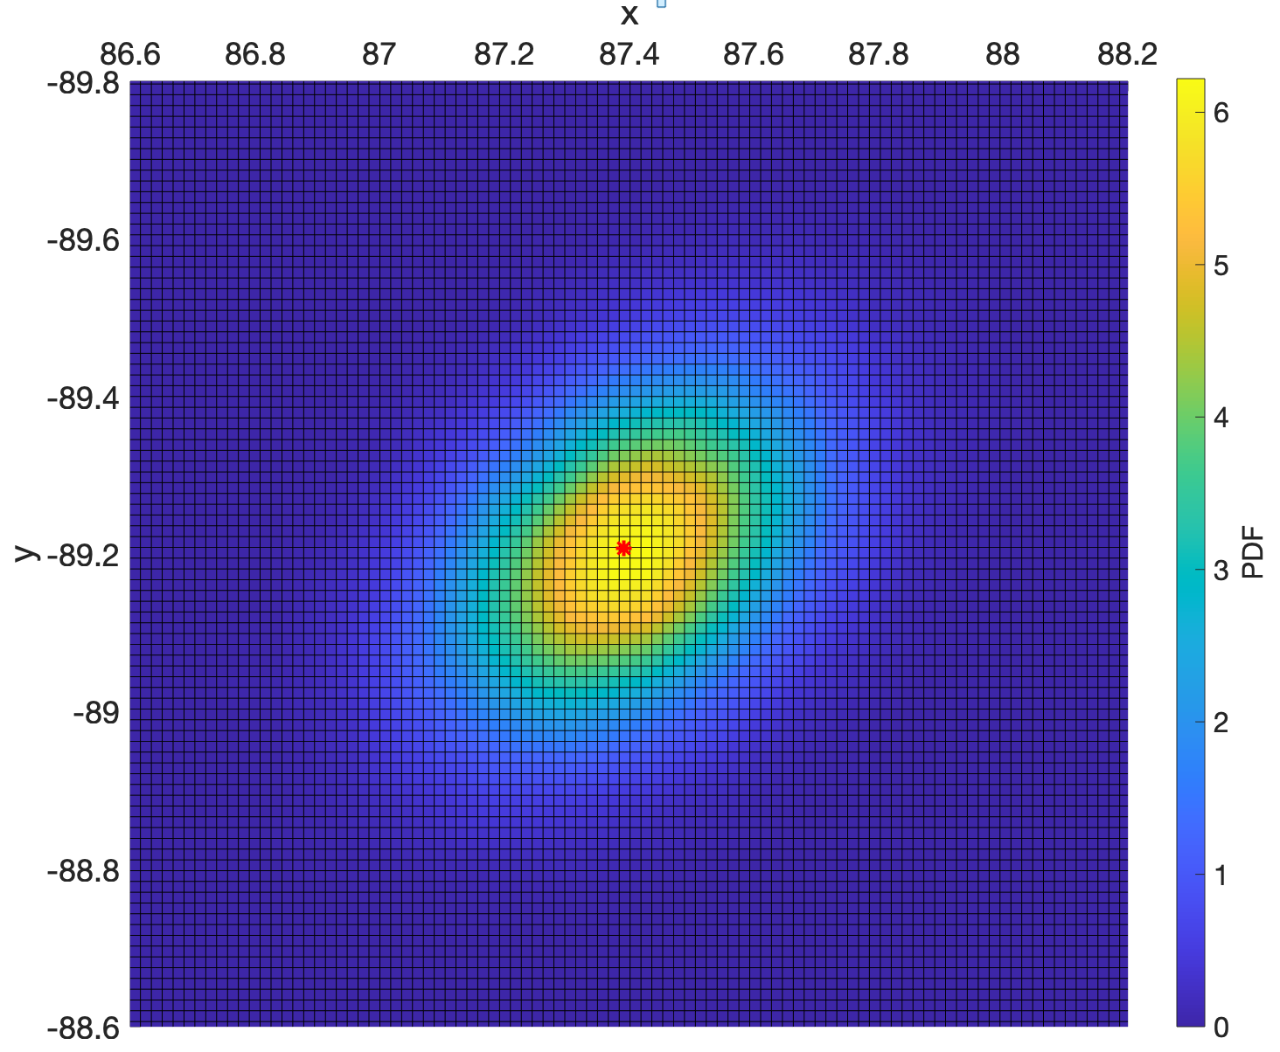
Accuracy
Uncertain input: well trajectory (noise on survey points)
$$σ=7.29\text{lbf}$$
Distribution of cable end points
Spatial pdf of cable end points
$$σ_{x}=0.18\text{ft}$$
$$σ_{y}=0.14\text{ft}$$

Slide 14
Accuracy
Convergence strategies:
Choose a high order representation (4-5) and monitor the convergence of QoIs with increasing number of samples
For Gauss quadrature -> automatic choice ?
Set the number of samples according to the computational ressource

Slide 15
Outline
Accuracy
Computation time
Estimation of Quantities Of Interest
Conclusions and prospects

Slide 16
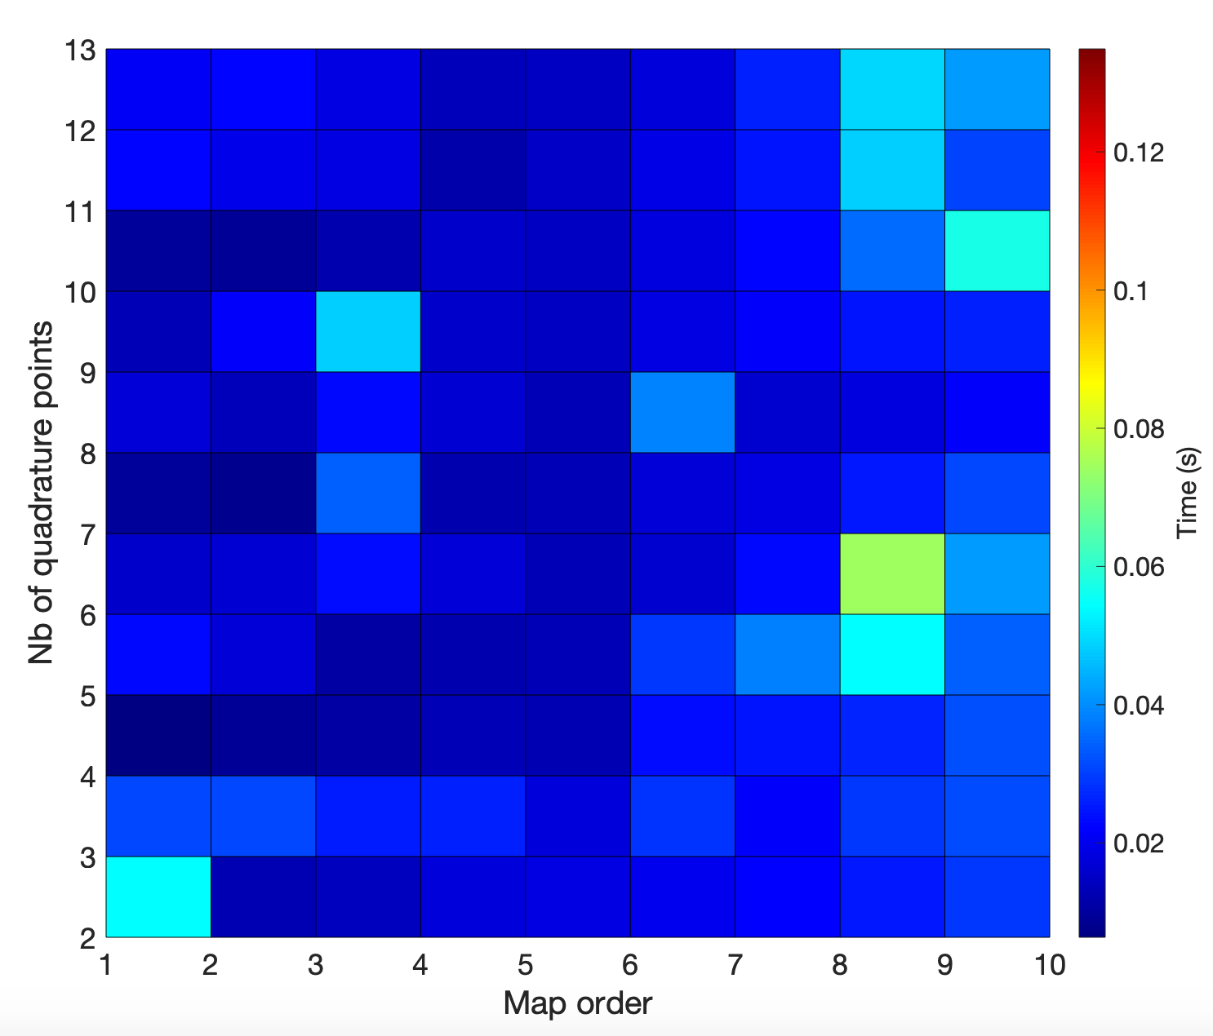
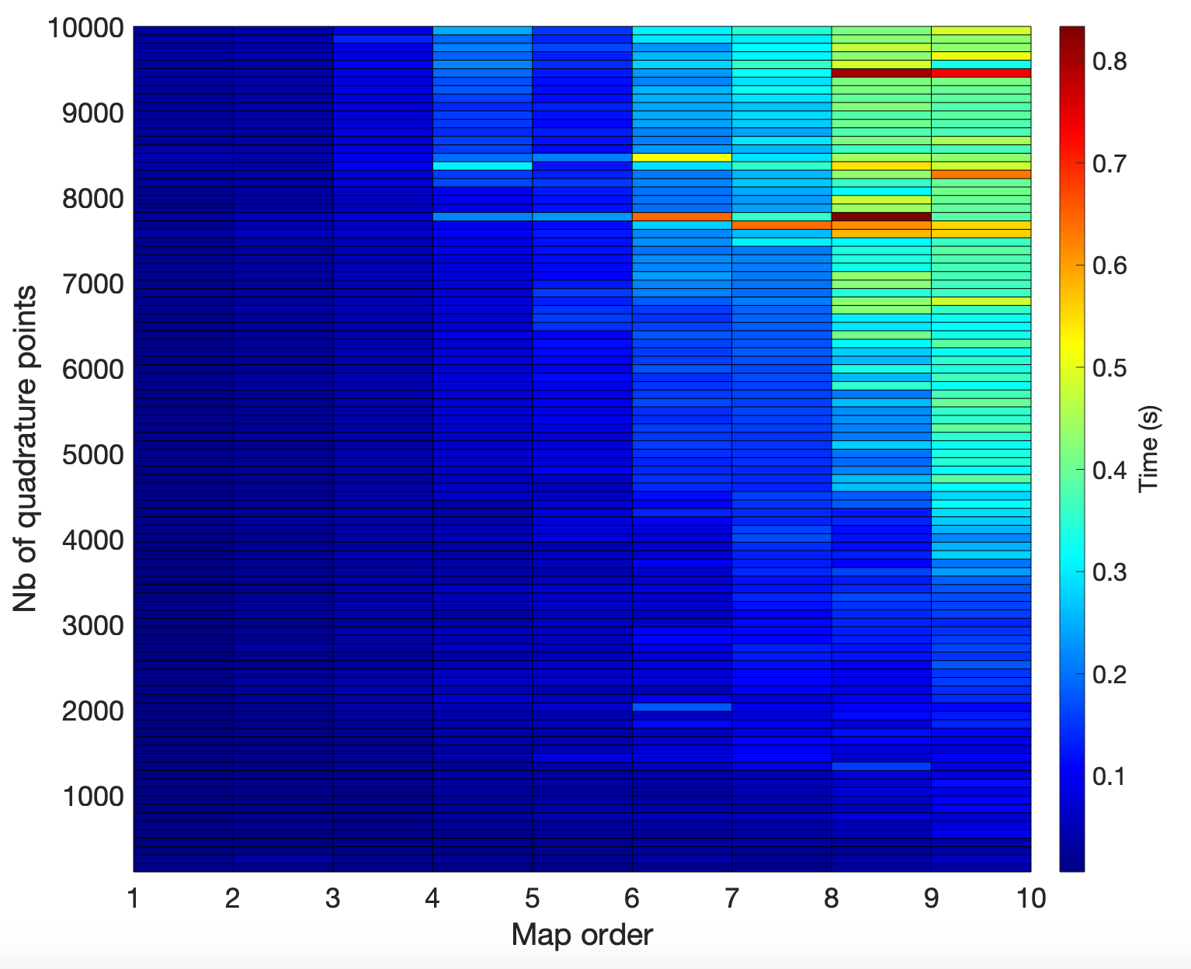
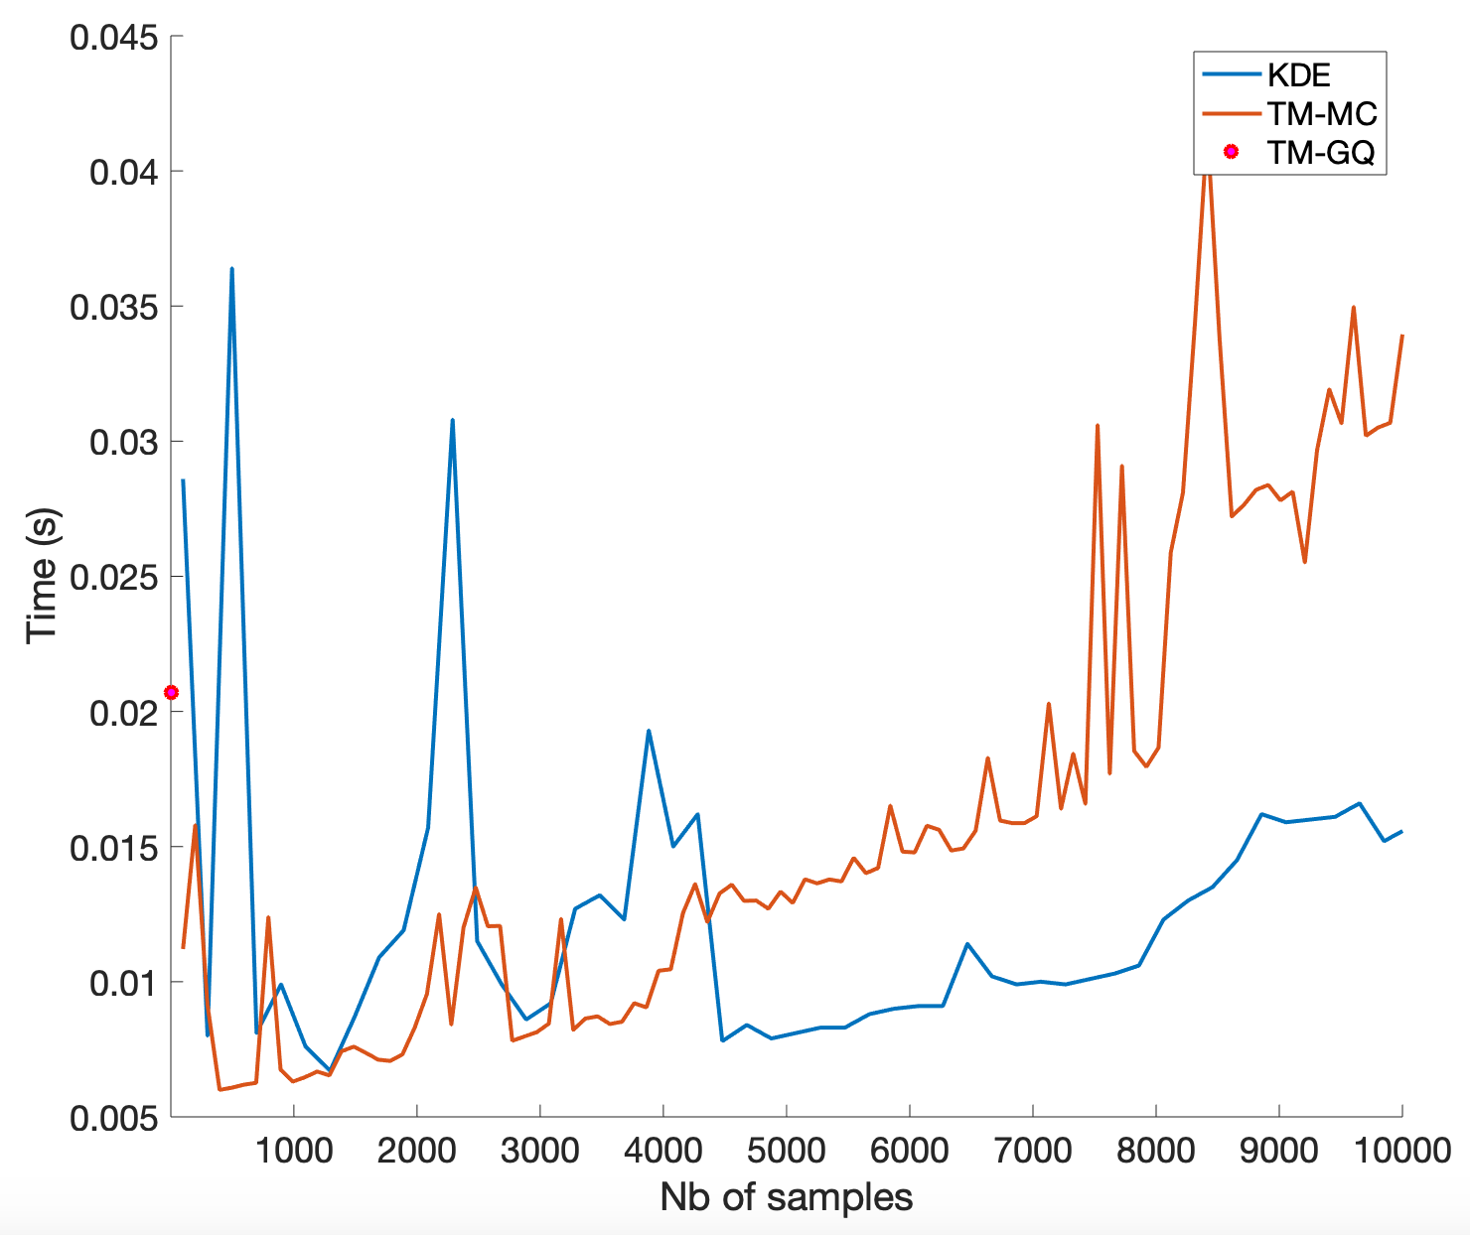
Computation times
Uncertain input: friction coefficient
TM Gauss Quadrature
TM MC Quadrature
TM vs KDE
Model evaluation cost $≈1\text{s}$ (16 CPUs)

Slide 17
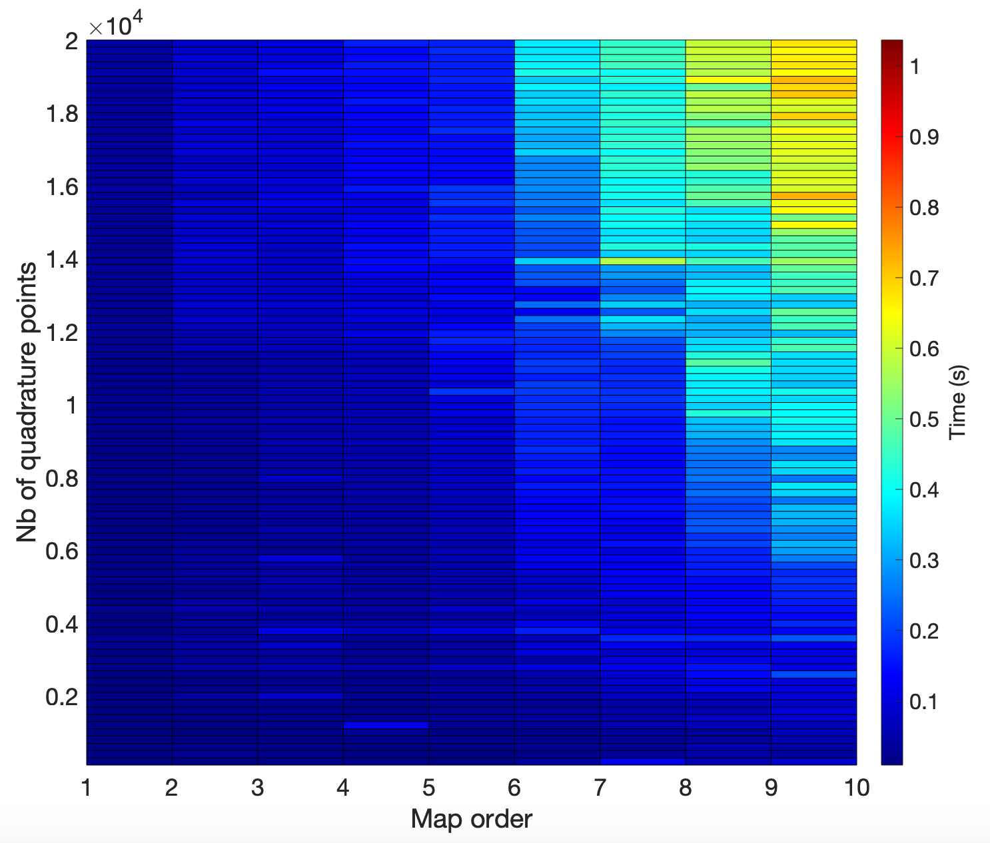
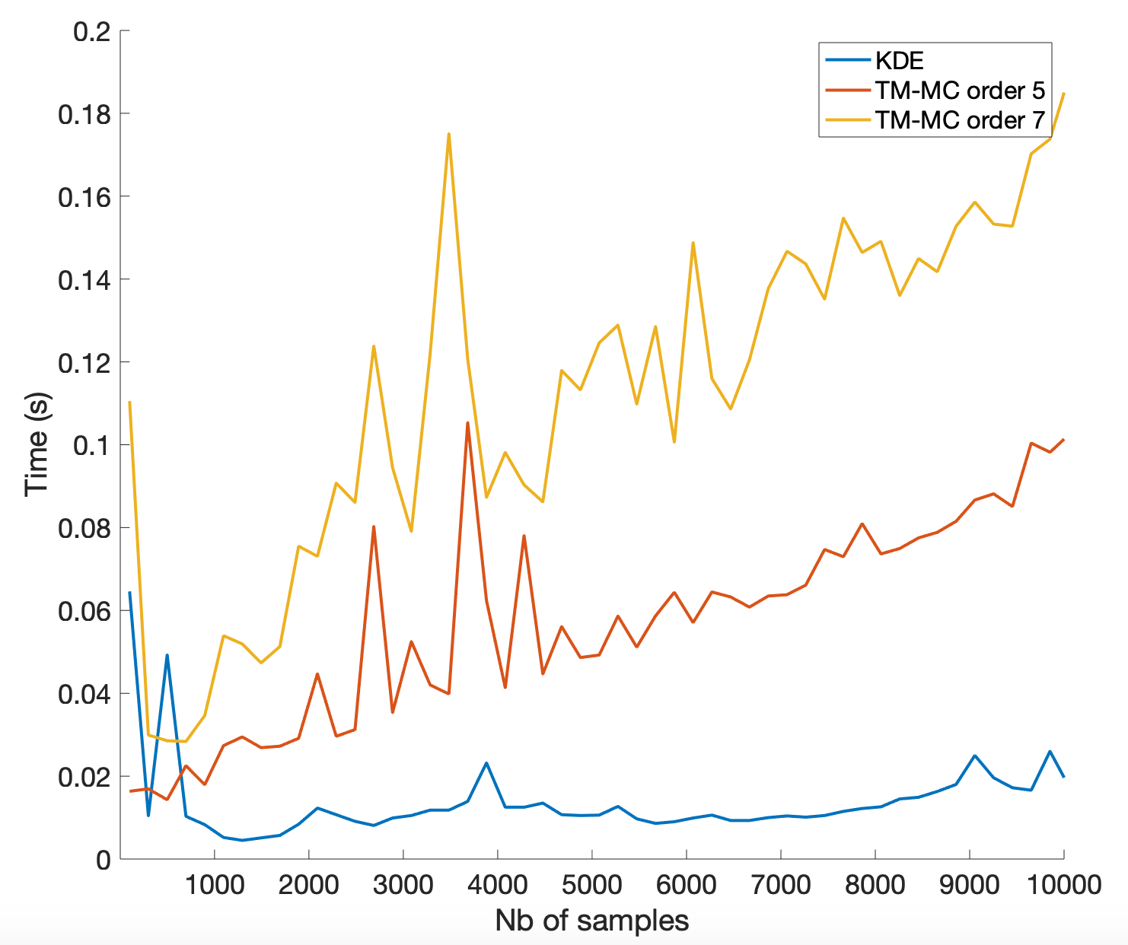
Computation times
Uncertain input: survey points
TM MC Quadrature
TM vs KDE

Slide 18
Outline
Accuracy
Computation time
Estimation of Quantities Of Interest
Conclusions and prospects

Slide 19
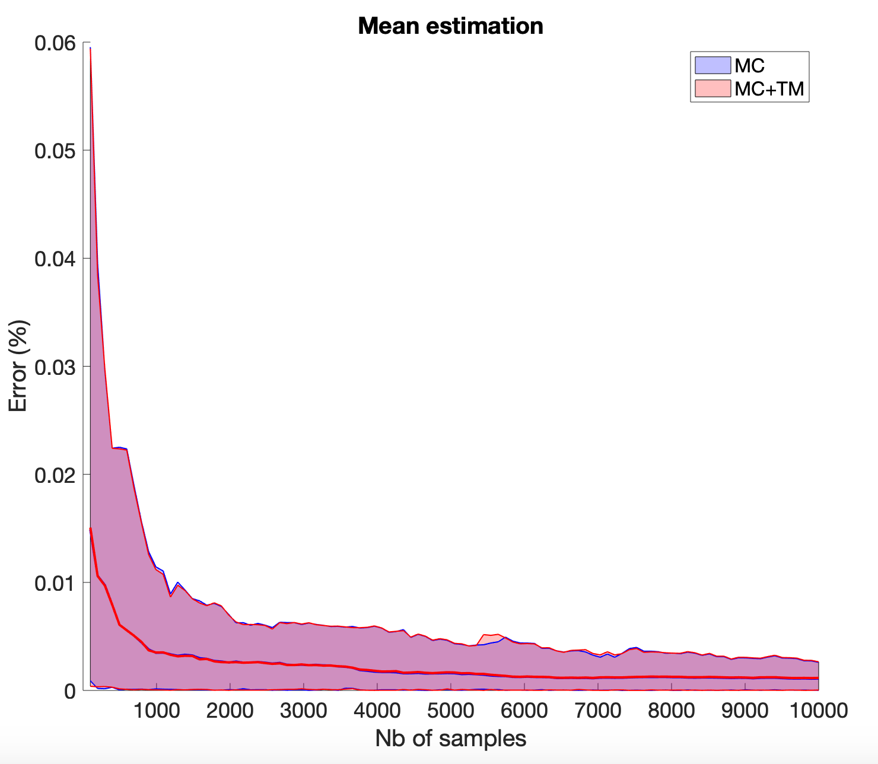
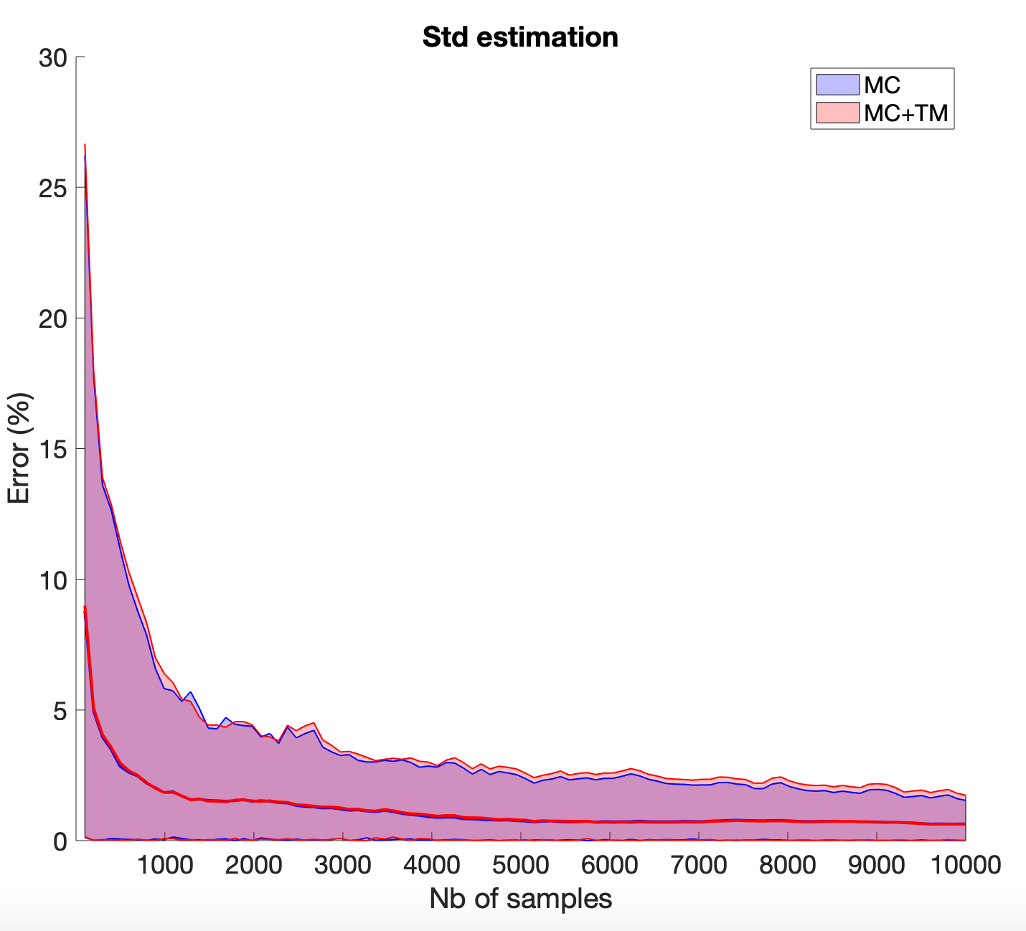
Estimation of QoIs
Moments estimation

Slide 20
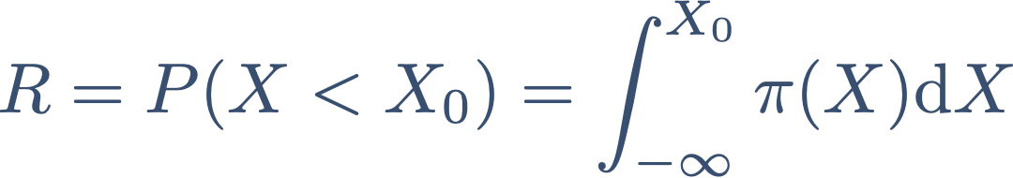
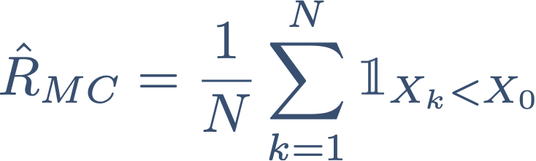
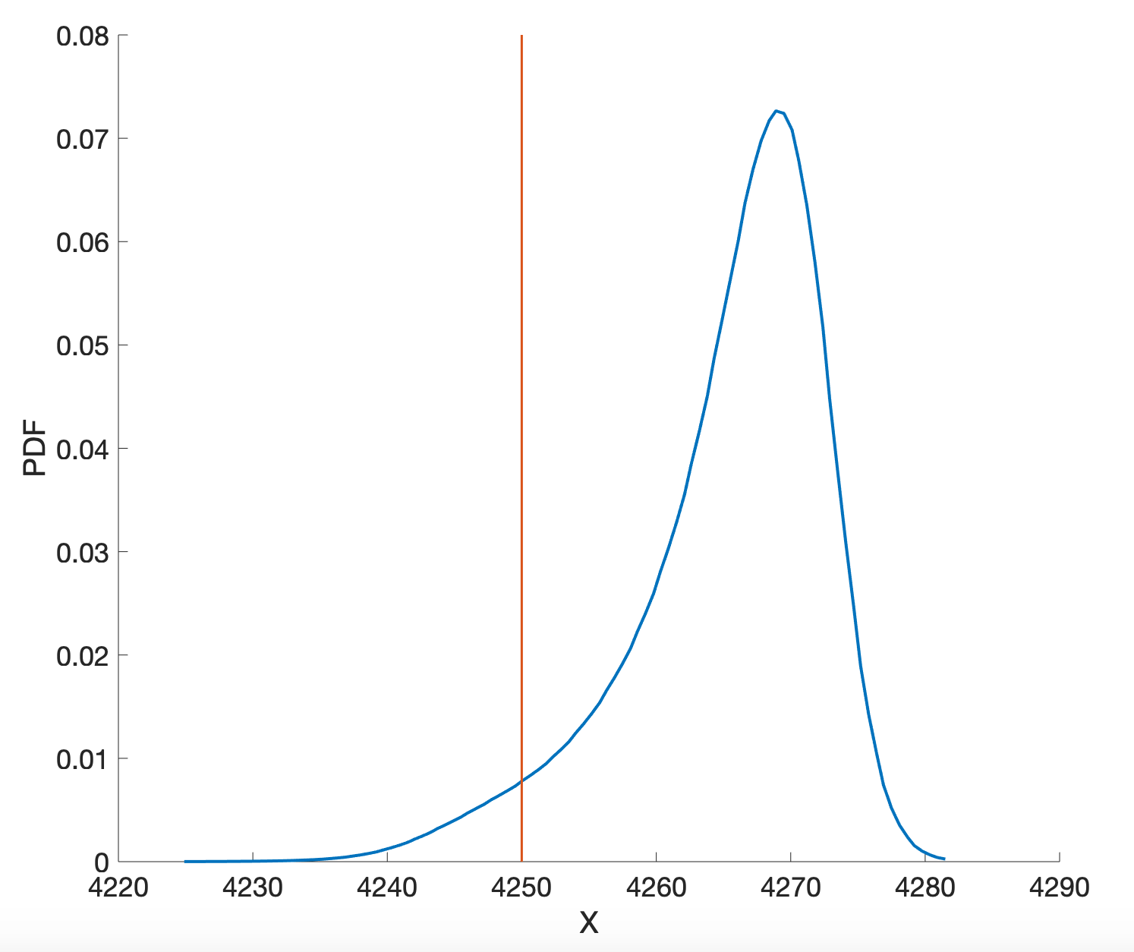
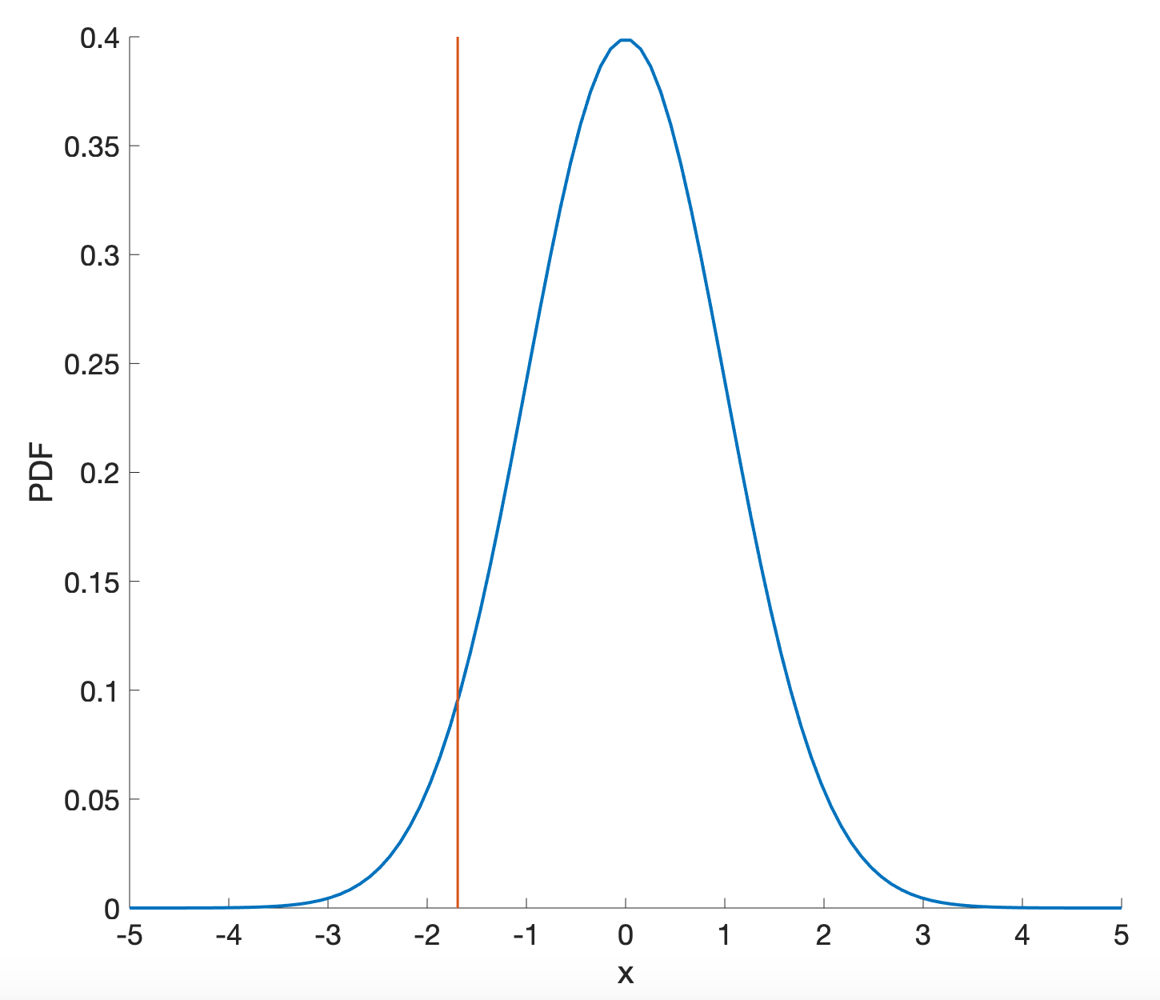
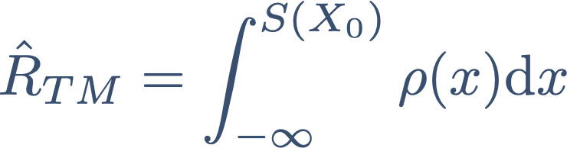
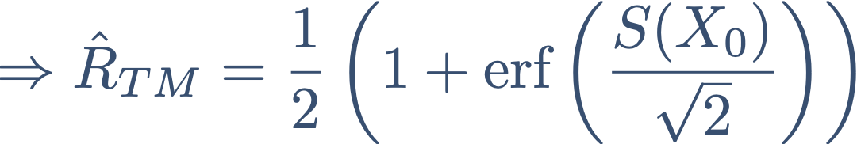

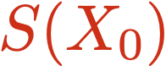
Estimation of QoIs
Risk estimation (after geometry uncertainty propagation)
Compute the QoI:
From MC samples:
From MC samples and TM:
$$S$$

Slide 21
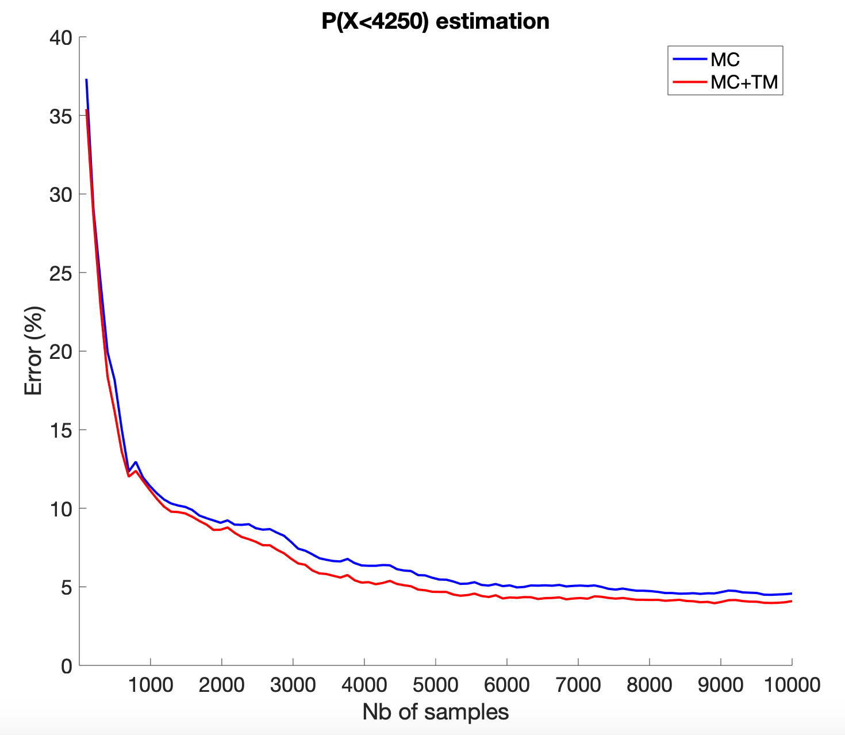
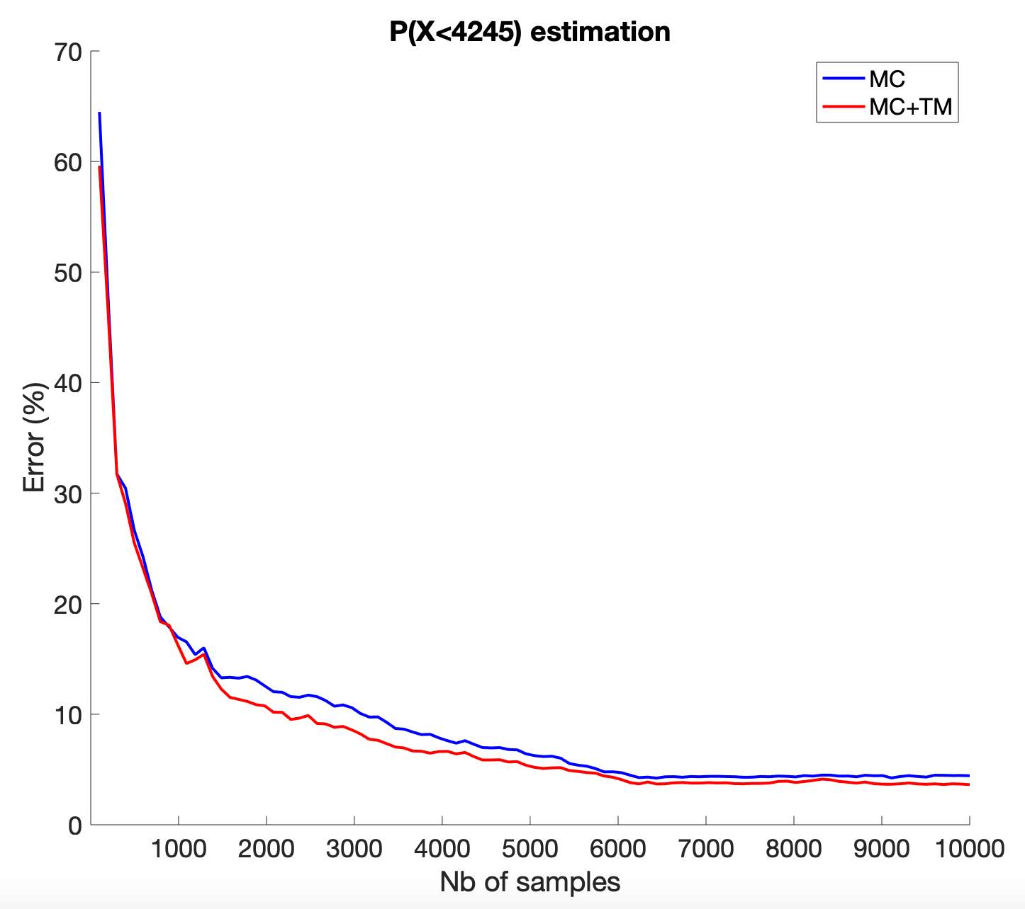
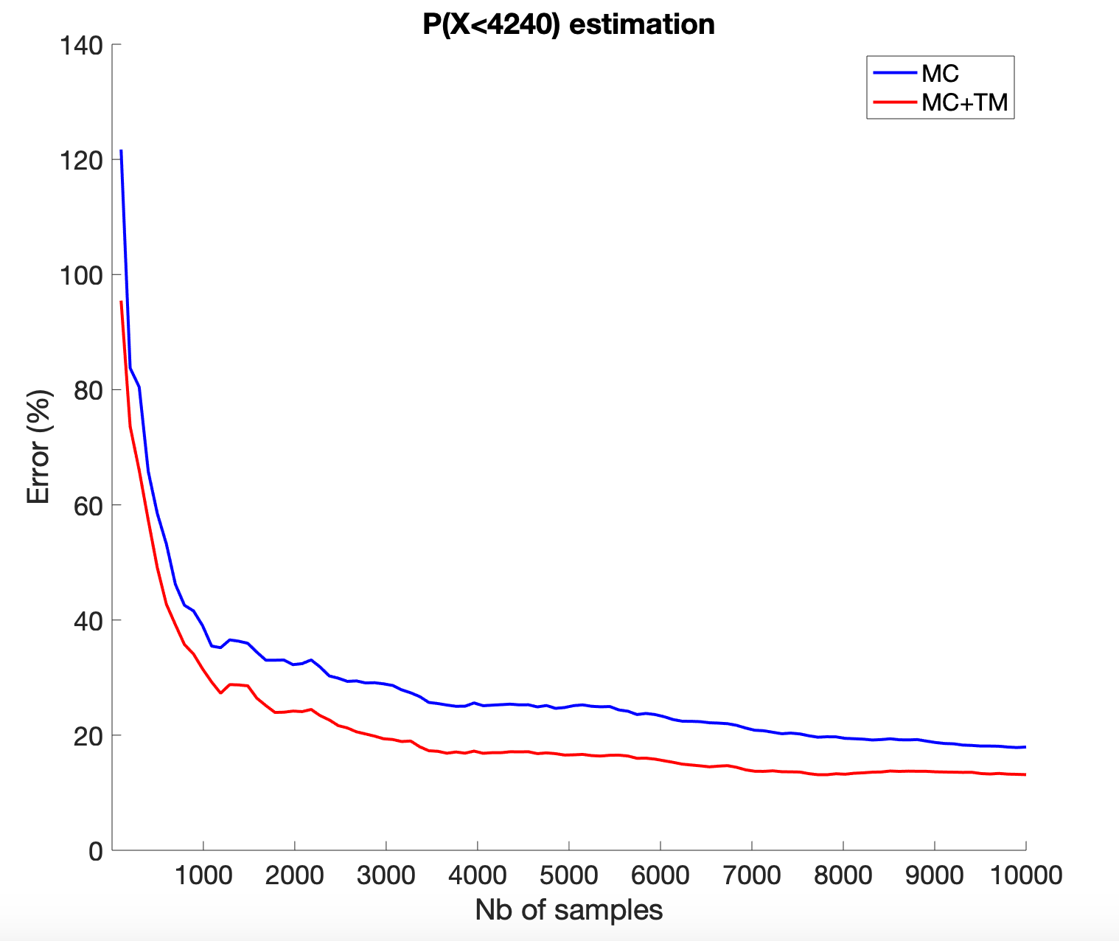
Estimation of QoIs
Risk estimation (after geometry uncertainty propagation)
Complex quantity to compute due to fat tail (and ever more complex a the threshold becomes smaller)
Transport map is computed with order (here 7)
$$ΔS=4455$$
$$ΔS=6633$$
$$ΔS=4200$$
Extrapolation property + no integration bias

Slide 22
Estimation of QoIs
Use of transport maps for forward UQ:
Analytical formulation of the output pdf (can be used for likelihood based Bayesian inference)
Less variance in the results vs KDE (none with GQ)
Compact the information: samples are converted to a map allowing model free sampling (deterministic and MC)
Can speed-up computation of probabilities (ex: risks)

Slide 23
Outline
Accuracy
Computation time
Estimation of Quantities Of Interest
Bayesian parameter update
Conclusions and prospects

Slide 24
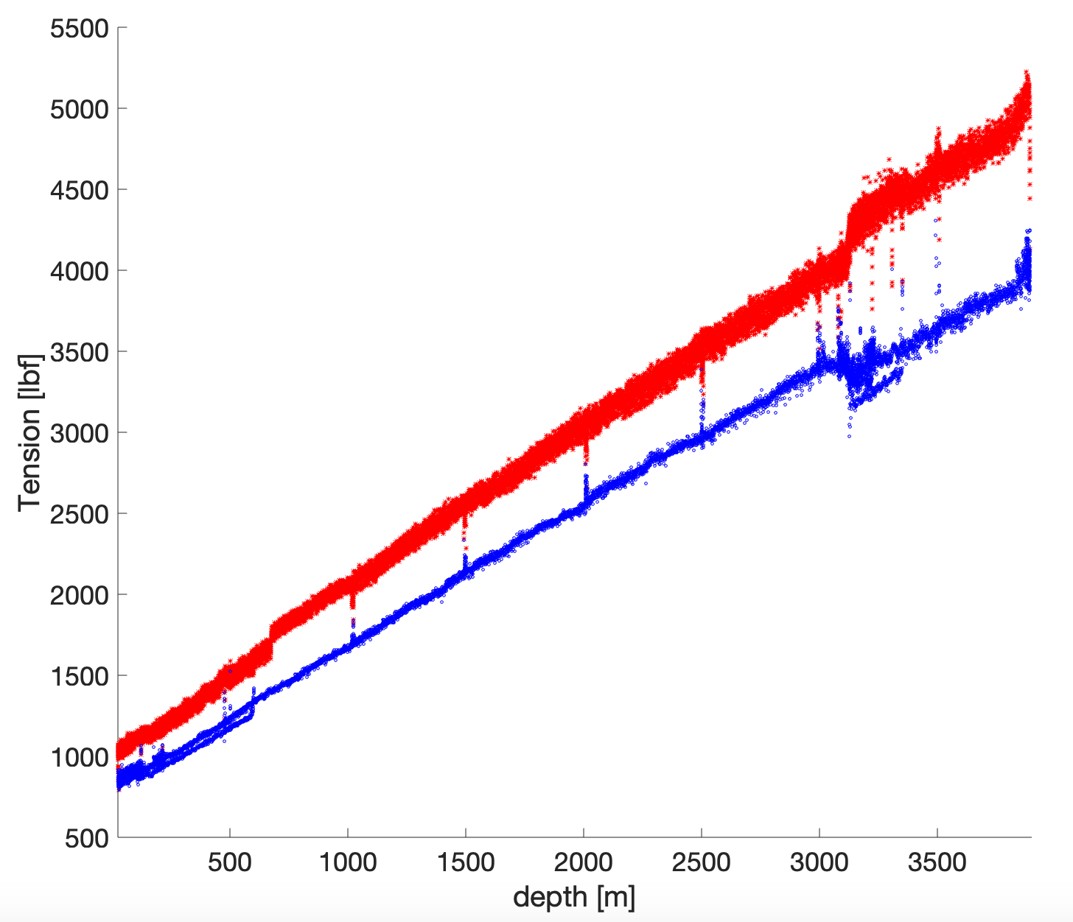
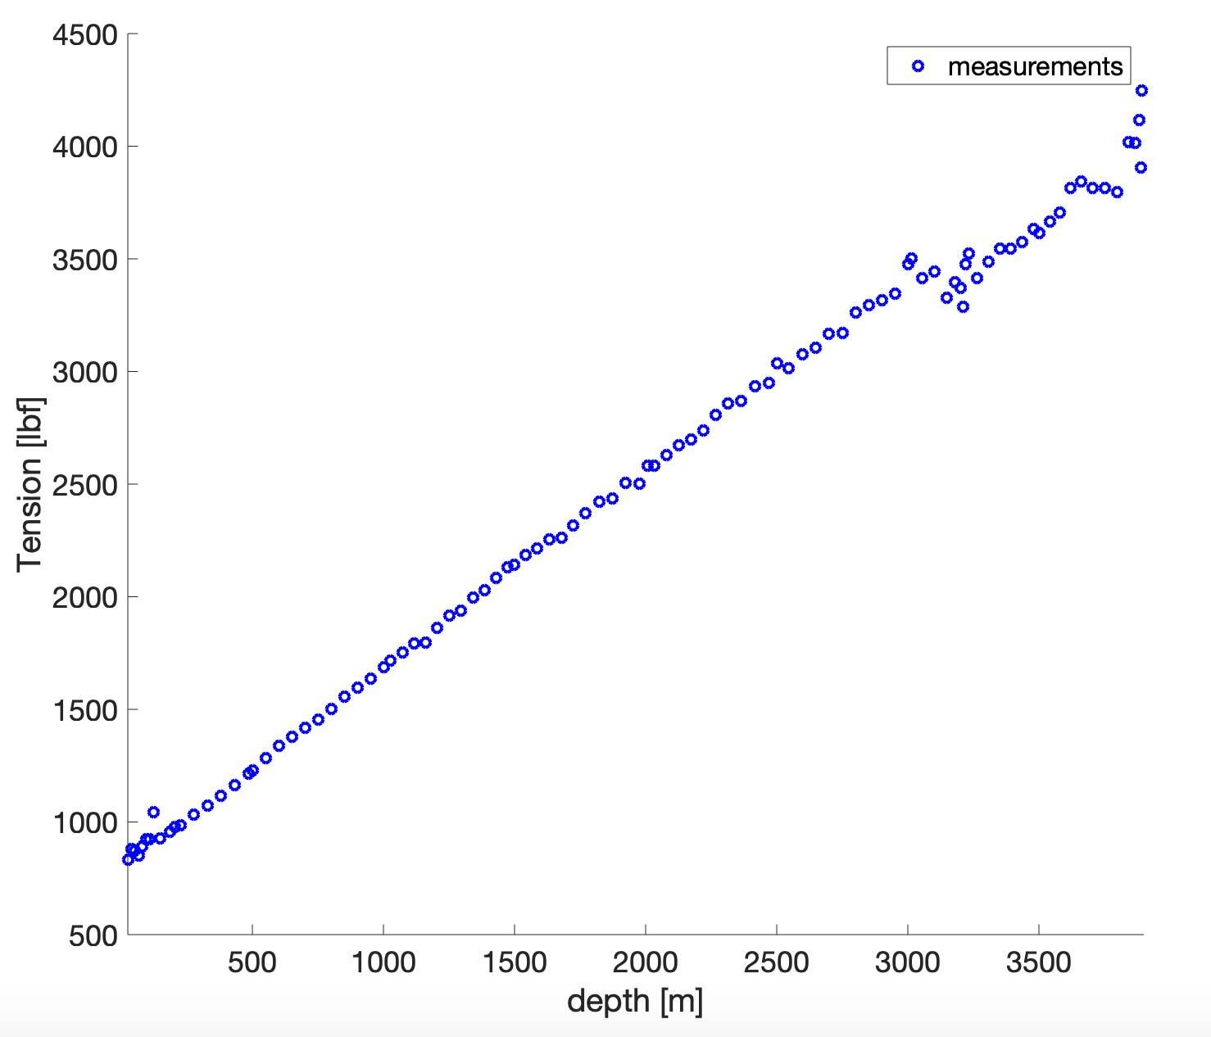
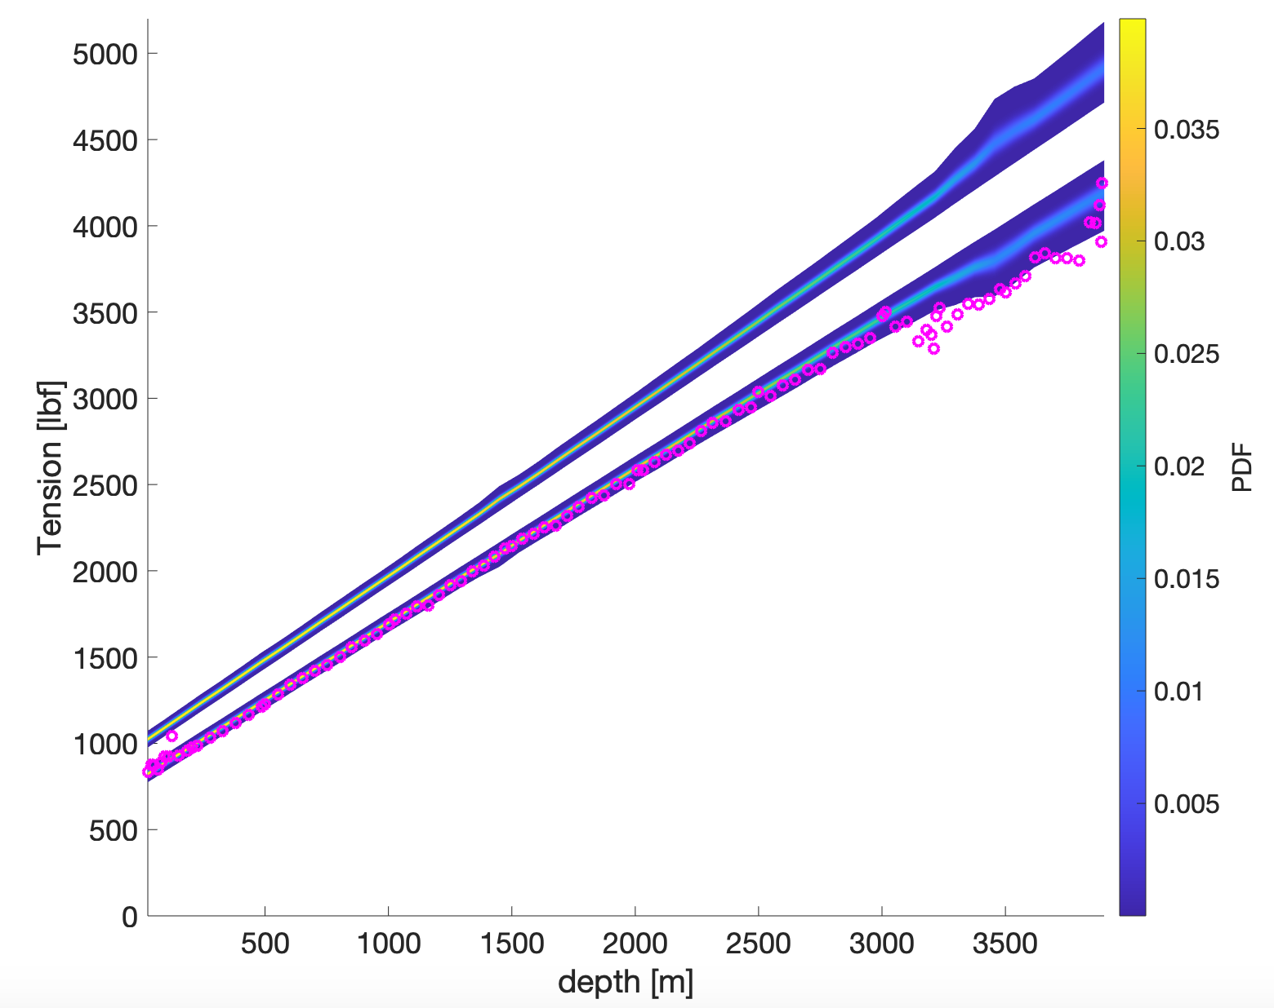
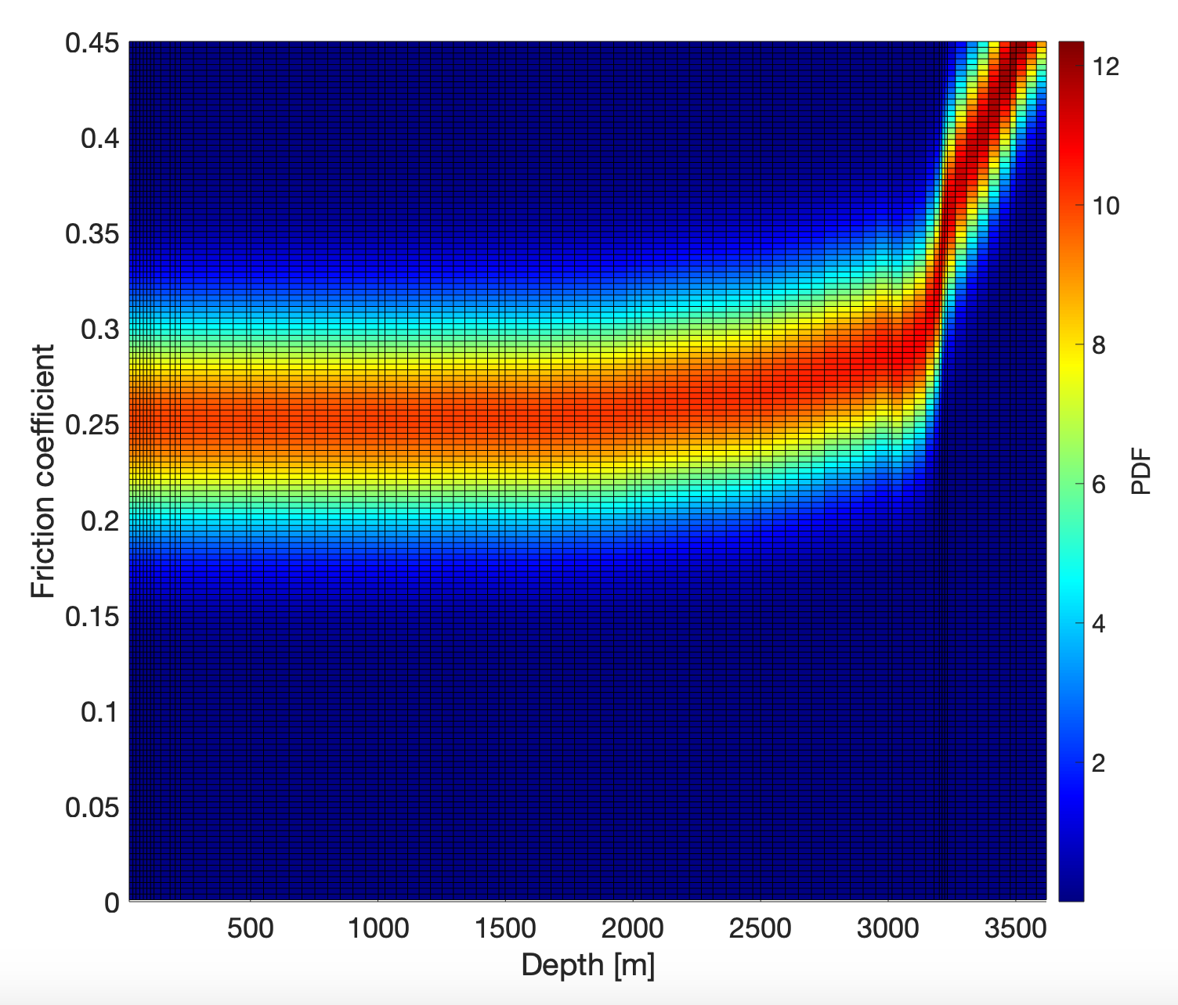
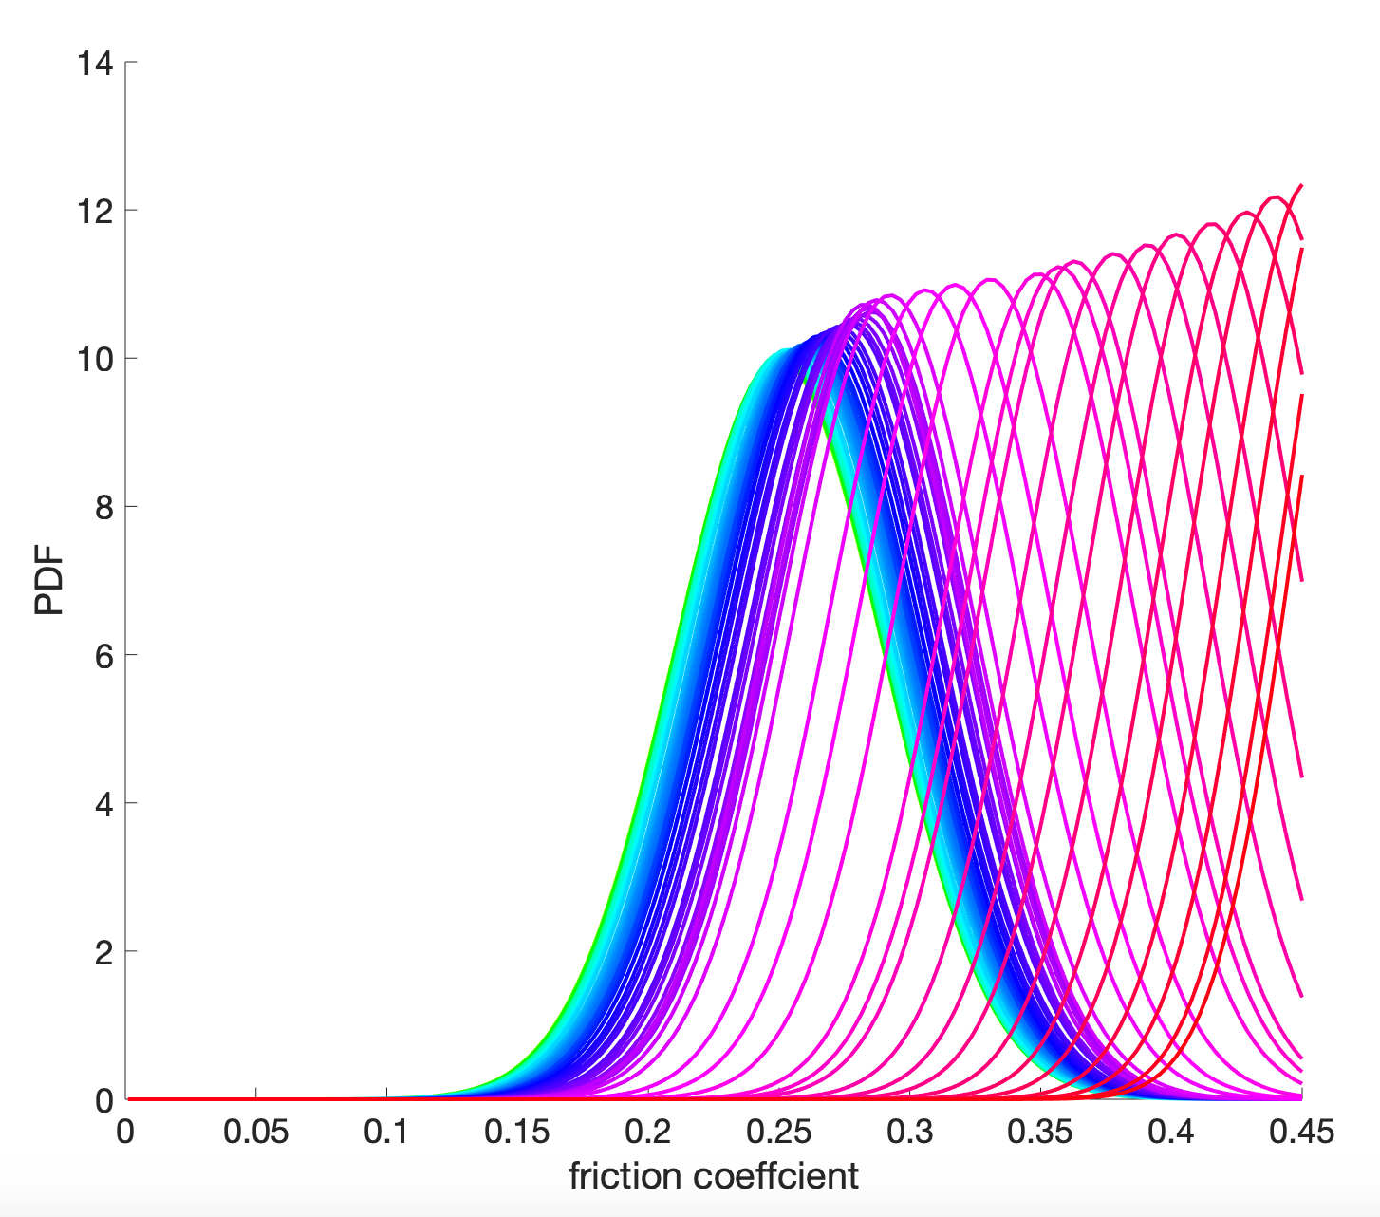
Bayesian parameter update
Data

Slide 25
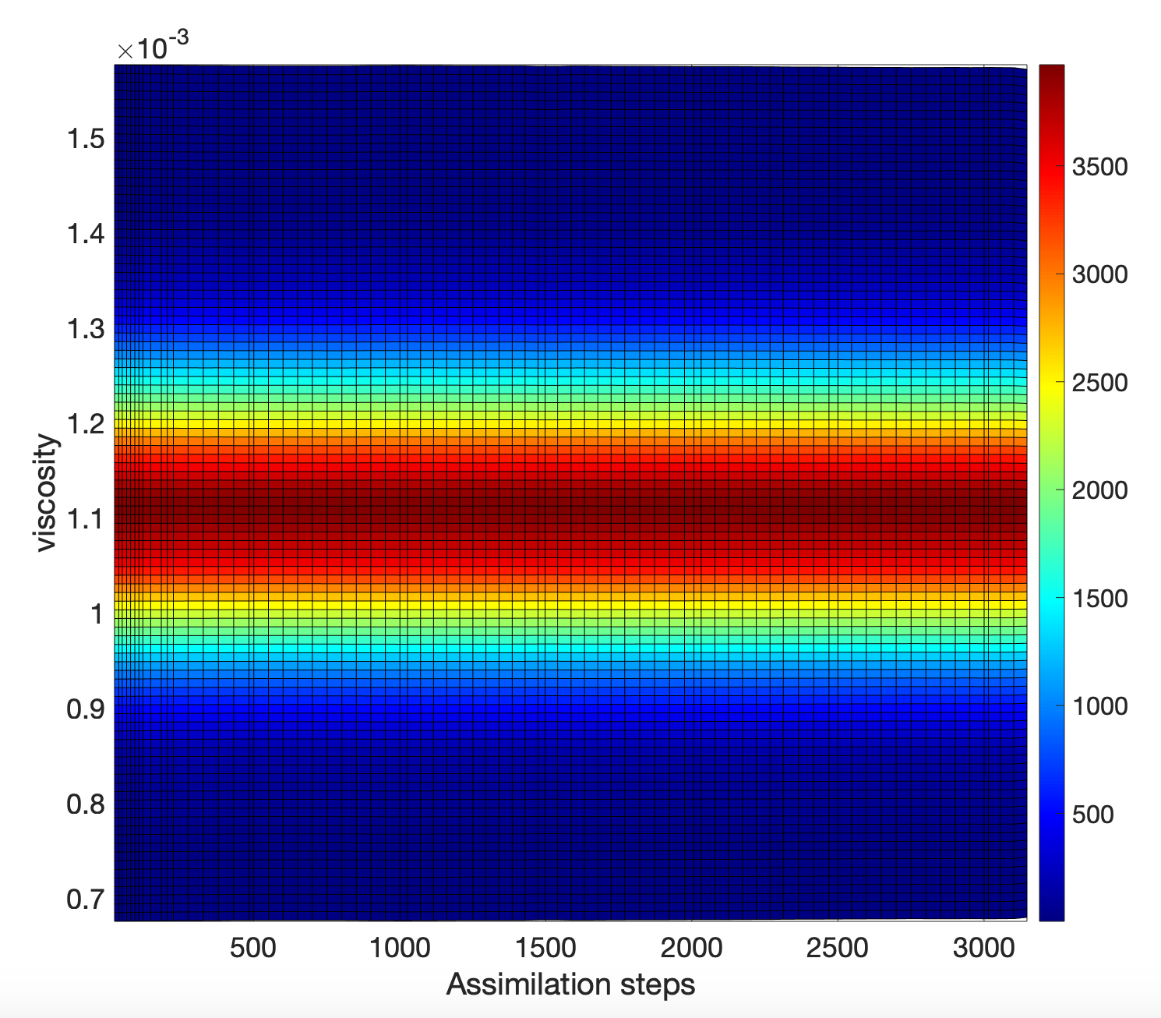
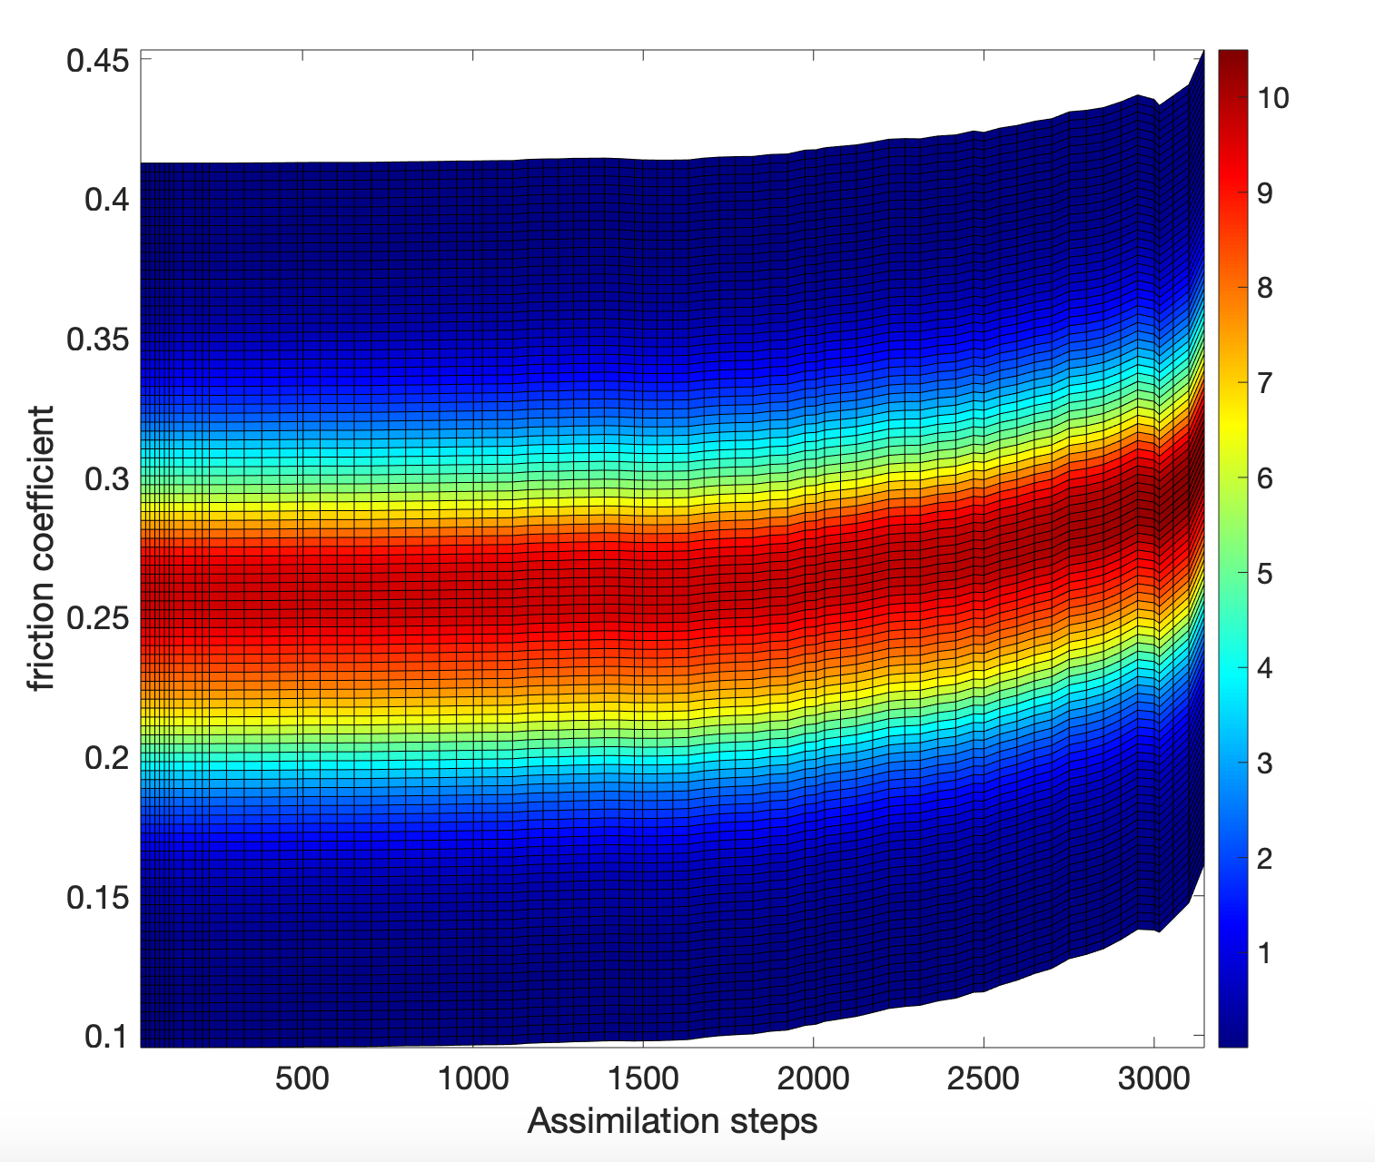
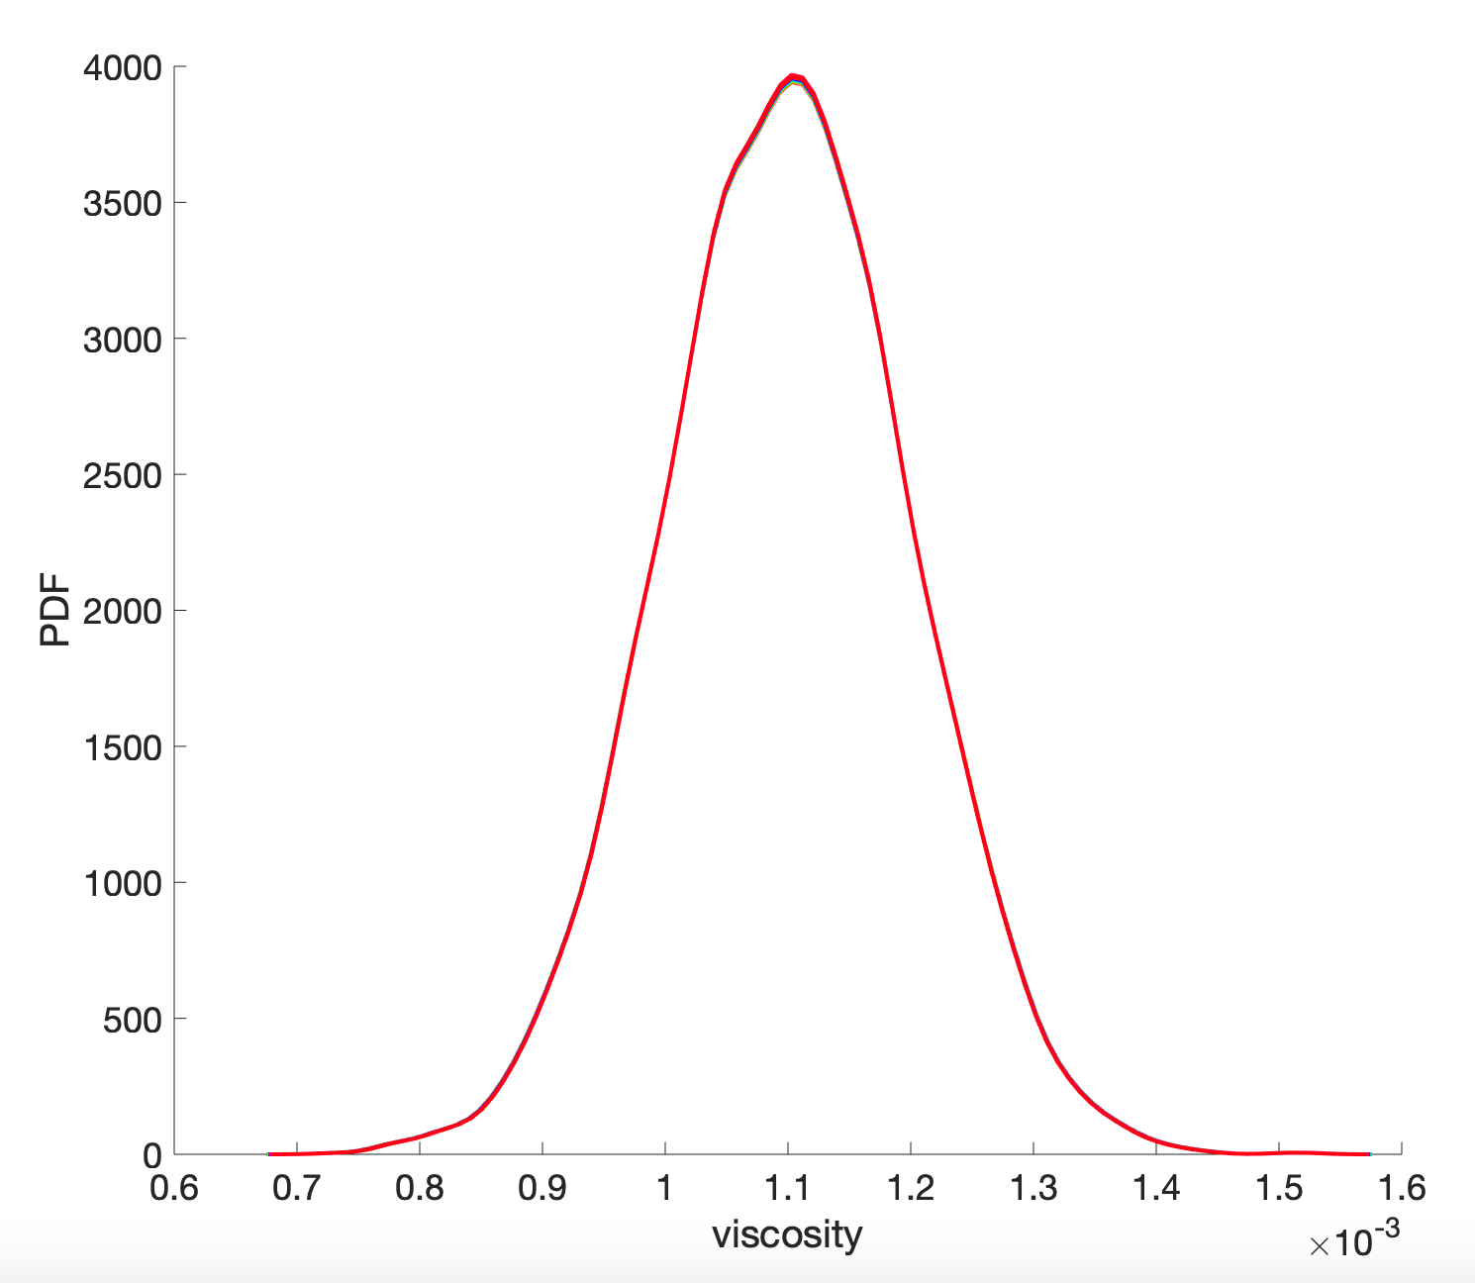
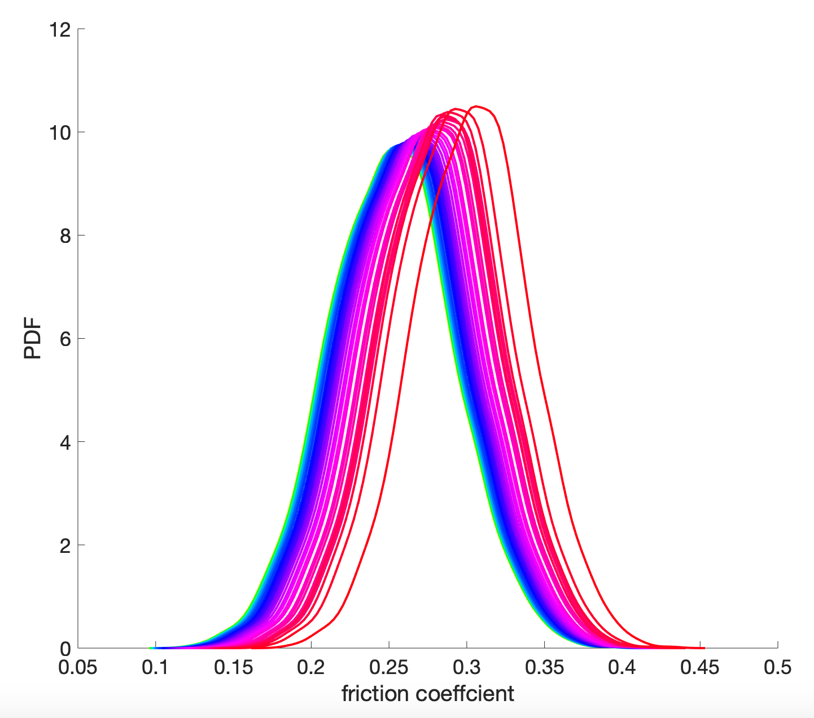
Bayesian parameter update
True data

Slide 26
Outline
Accuracy
Computation time
Estimation of Quantities Of Interest
Conclusions and prospects

Slide 27
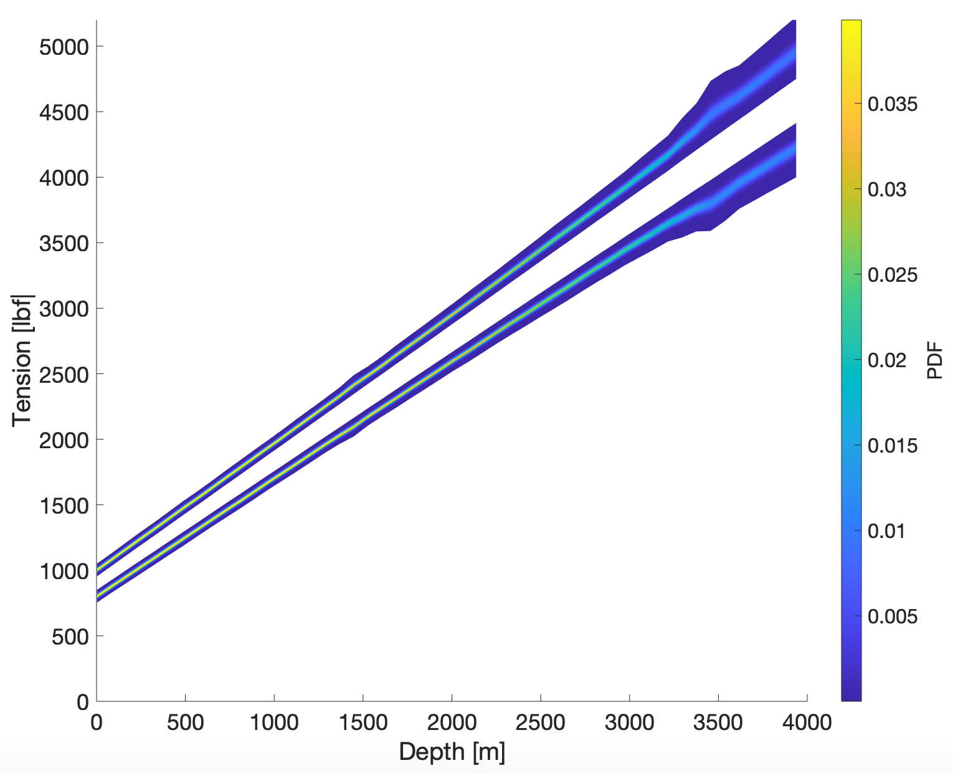
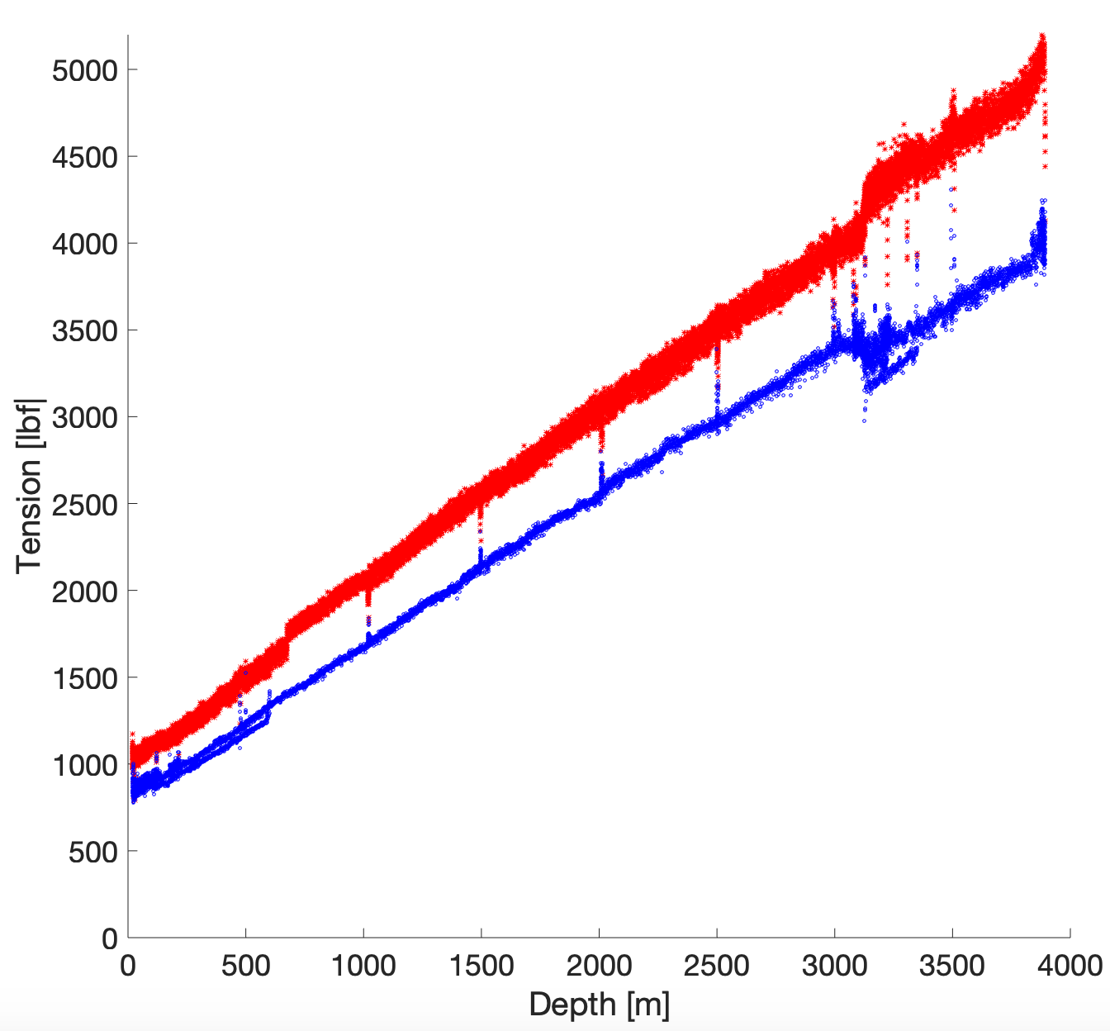
Forward UQ for all cable lengths
Uncertain inputs
Friction coefficient: Gaussian pdf with $μ=0.25$ and $σ=0.08$ truncated at 0
Surface friction: Gaussian pdf with $μ=100$ and $σ=10$ [lbf]
Uncertainties
Data

Slide 28








Improvement 1: Bayesian inference
Lead: Likelihood free inference
GP of survey points
Draw samples from priors:
Bayesian prior
Compute model outputs: for
Marginalization over :
Compute the triangular transport map such that:
5
Then from the map structure property:
Bayesian posterior
Spantini A, Baptista R, Marzouk Y. Coupling techniques for nonlinear ensemble filtering. 2019

Slide 29
Improvement 1: Likelihood free inference
Benefits of the method:
Takes into account aleatory parameters
Exploits the structure of triangular maps to build map characterising Bayesian posterior
Avoid computation of derivatives
Reduce number of online model evaluation
Remaining questions:
Number of samples for desired accuracy
Control of the accuracy
Cost for transporting samples (inverse map)
Sequential setting

Slide 30


Improvement 2: goal oriented accuracy
Goal: Have the most accurate QoI possible with the less complex map to compute
Example with risk assessment:
$$S$$
High accuracy is only needed for
We want to focus all the given computational ressource (given map order) to the estimation of a given QoI
Strategy will serve both map from samples and map from density

Slide 31




Improvement 2: goal oriented accuracy
Not the current behaviour of transport maps approximation:
Order 1 approximationn
Order 2 approximationn
Order 5 approximationn
Accuracy is focused on the mode of the distribution
Accuracy on the tails is bad here due to different tail heaviness/fatness/length between Normal and Gumbel distribution
The ratio in KL-divergence is not sensitive in regions of large different tail behaviours

Slide 32


Reducing computation time
Lead: Tail-focused divergences
Goal: Replace the classic KL divergence with a more tail focused divergence:
6
7
8
Renyi, (Adapted) f-divergence, AB-divergence
Mode seeking
Mass covering
Outliers focused
Robust to outliers
Li Y, Turner R. Rényi Divergence Variational Inference. 2016
Wang D, Liu H, Liu Q. Variational Inference with Tail-adaptative f-divergence. 2019
Regli JB, Silva R. Alpha-Beta Divergence For Variational Inference. 2018

Slide 33



Reducing computation time
Application to transport map computation
Order 2 TM approximation
$$(α,β)=(-1,2)$$
$(α,β)=(1,0)$ (KL-divergence)
Order 2 TM approximation

Slide 34




Reducing computation time
Remaining questions:
Optimal choice of $(α,β)$
Structure and cost of the functional to minimize
Adapted parameterisation of the maps
Mode seeking
Mass covering
Outliers focused
Only two possible minima ?
Robust to outliers

